Slide 1
How a Spacecraft Mission is Developed
Bob Dutilly
NASA Retired
Howard Dew
NASA Retired
Peter Chen
Astronomer GSFC
January 17, 2019
Notes:
Ask questions all are good I will be trying to tell a story about a s/c mission

Slide 2
Agenda
Introduction
Initial concepts for a spacecraft mission
Peer review process
Approval and funding process
Headquarters decision process
Personnel selection process
Facilities
Documentation process
Requirements process
Design process
Review process
Facility Testing
Telemetry and Command Systems
Coordination process
Facility Interface Testing
Observatory Testing
Integration testing
Launch Site testing
Spacecraft and Observatory instrument testing after launch
Ongoing support of the satellite and science data processing
Spacecraft Bus and Launch Vehicle
Conclusion and Issues
Citations
Notes:
Lot of material – this presentation will be a brief coverage of an entire spacecraft project

Slide 3
Introduction
A satellite is made up of two parts that communicate with each other, then to/from the communications site and then to/from the ground
  A spacecraft bus
  Science Observatory
Types and Costs of missions
  Observatory Class - $1 billion and more
  Medium Class (MIDEX) - $180 to $240 million
  Small Explorer (SMEX) - up to $120 million
  University Class (UNEX) – up to $15 million
  CubeSat – up to $1 million
Communications to and from the satellite
  Tracking and Data Relay Satellite System (TDRSS)
  Deep Space Network (DSN)
  Mission specific ground station
  Commercial ground station
3
Notes:
I will try to bring in some of my own experiences while working on various missions

Slide 4
Introduction (Continued)
Earth Orbits
  Low Earth Orbit (LEO) 100 to 1200 miles
  Medium Earth Orbit (MEO) 1250 to 22,000 miles
  High Earth Orbit (HEO) 22,200 to 26,000 miles
  Geosynchronous (GSO) 26,200 miles
  Geostationary (GEO) 26,200 miles
Lagrange Orbits 932,00 miles from earth
  L1
  L2
  Station Keeping about every 22 days
Moon Missions
  LRO, Lunar Prospector
Deep Space Missions
  Cassini, Galileo, JUNO, numerous Mars missions
6
Notes:
Leonhard Euler and Joseph-Louis Lagrange – there are five Lagrange points between two gravitational bodies

Slide 5
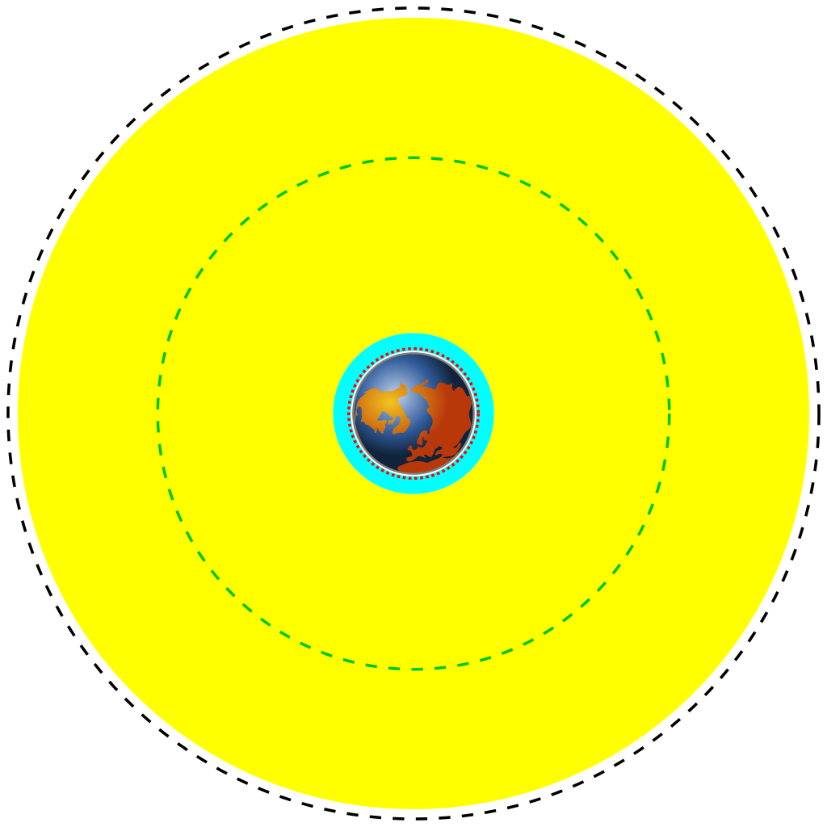
6
Notes:
Red circle – LEO Blue circle and some of yellow – MEO Yellow circle – HEO usually elliptical Black circle – GEO, GSO Green circle – GPS satellites

Slide 6
Initial Concepts for a Spacecraft Mission
The ideas for a mission can come from a variety of places
  NASA Headquarters as an Announcement of Opportunity (AO) or a Response for Proposal (RFP)
  NASA Center scientists
  JPL scientists
  University scientists
  Private industry scientists
  European Space Agency (ESA) and other foreign space agencies in contact with NASA headquarters
  NOAA scientists for weather and earth observing
Notes:
Something different – 4 groups – scientists, communications, MOC, Command Management, FDF

Slide 7
Initial Concepts for a Spacecraft Mission (continued)
Spacecraft Mission
Launch Vehicle
Science Observatory
Spacecraft Bus
Instruments
Computers/Power
Spacecraft Subsystems
Science Ops
Mission Control
Communications
Flight Dynamics
Other Facilities also
Notes:
Other facilities – such as spacecraft bus contractor

Slide 8
Initial Concepts for a Spacecraft Mission (continued)
Spacecraft Bus components
  Power -- solar panels, Radioisotope Thermalelectric Generator (RTG), long term batteries
  Communications -- High gain and low gain antenna’s
  Star Trackers -- optical device pointing to a star(s) and locks on to maintain directional control which measures the position of stars
  Thermal blankets -- keeps component systems within acceptable temperature ranges
  Gyroscopes -- provides spacecraft stabilization and control
  Recording Devices -- saves data for later downloads
  Batteries -- used after launch until the solar arrays are deployed
  Propulsion -- hydrazine fuel or ION engines (electric propulsion)
  Main and backup computers -- this is the On Board Computers (OBCs)
Space qualified parts are used which may seem “out of date” by the public but are important for a successful mission
  Legacy equipment versus new equipment
Notes:
Parts to become space qualified takes quite a bit of extra testing and time

Slide 9
Initial Concepts for a Spacecraft Mission (Continued)
Observatory
  Main computer that connects between the spacecraft bus and the instrument(s)
  One or more science instruments
  Computer for each instrument with software to communicate not only with the instrument(s) but also with the main observatory computer
  High Voltage and Low Voltage power supplies
  Any additional sensors for fine pointing or for adding additional data for the instrument

Slide 10
Peer Review Process
One or more scientists on the mission concept will provide a presentation to other scientists on a panel not involved in the mission; those scientists on the panel will present detailed issues including pro’s and con’s for this mission concept
This presentation will give a detailed explanation of what the mission will accomplish and what value it has to the overall science
A detailed cost model for the mission will be developed and presented which also includes the cost of the spacecraft bus and more importantly what type launch vehicle that may be needed and very importantly its cost
Science drivers versus engineering constraints
Trade Studies are presented
  The mission objectives versus the constraints such as the instrument power required, the technology required (Technology Readiness Level #9 to #1) and the budget/time needed
  Identification of commercial of the shelf components (COTS) that can be used both for the observatory and for the ground systems
1

Slide 11
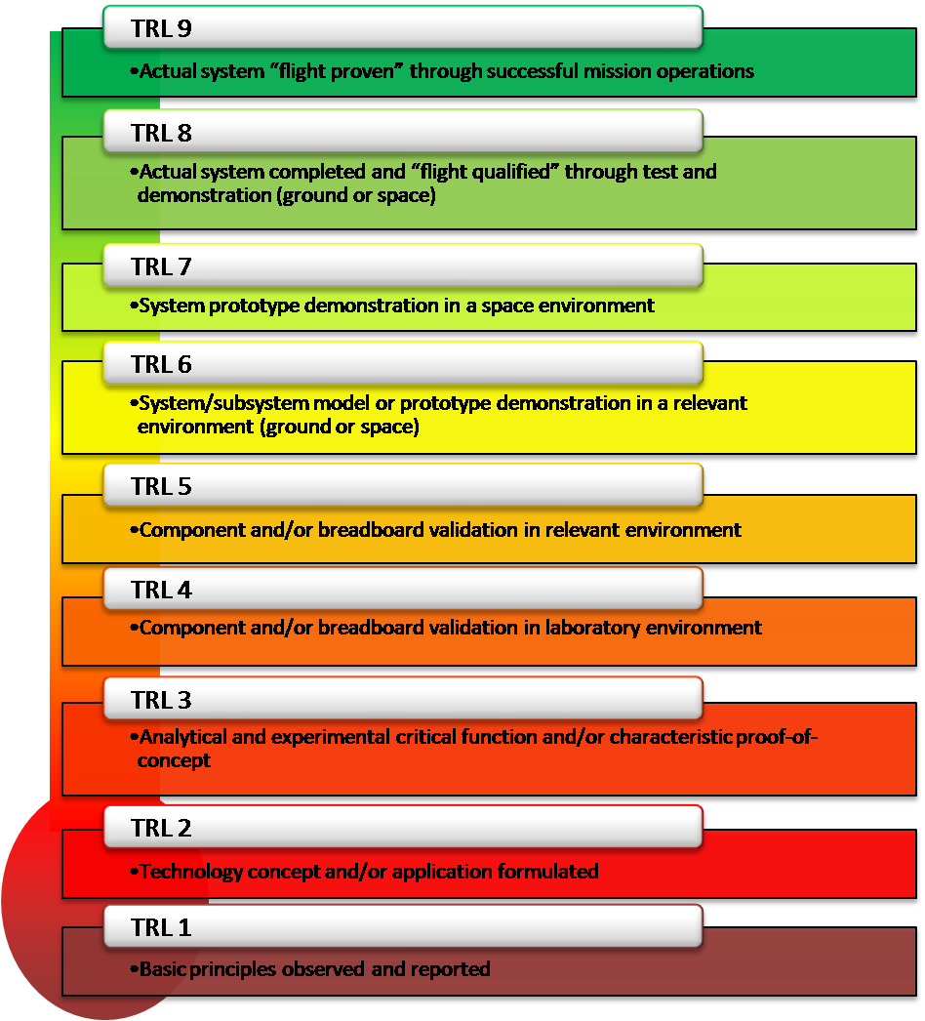
2
Notes:
Technology Readiness Level the higher the number the confidence that the part will function properly

Slide 12
Approval and Funding Process
NASA center, University, JPL, Private Organization
Headquarters
President
Congress

Slide 13
Approval and Funding Process (Continued)
CONGRESS
PRESIDENT
OSTP
HEADQUARTERS
Senate
NOAA
NASA Center
Authorization Committee
JPL
Appropriations Committee
ESA/other Agencies
University
Private Industry
House
Authorization Committee
Appropriations Committee
OSTP – Office of Science and Technology Policy
Notes:
Several of the smaller agencies use the OSTP since they do not have a “seat at the table” such as the EPA and NSF

Slide 14
Headquarters Process
Headquarters chooses which NASA center, JPL, University or Private organization that will develop, test and operate the mission
Many times it is a combination of the above organizations
It depends on what type of mission it is and which organization “bid” for that mission
Determination is made for the cost and budget for the mission and determines if it matches with the proposal from the science review team
Headquarters has its own panel of scientists which lay out a decadal set of science and technology projects for the next 10 years
Announcement of Opportunity (AO) from NASA Headquarters
  solicits proposals for participation in the NASA-led mission from scientists
Response for Proposal (RFP)
  This is a solicitation for a competitive proposal and the response is the proposal
  It is selected on technical capabilities and on price
2
Notes:
Call on scientists to determine what type of mission they want to have; then tell the other facilities what their job would be

Slide 15
Personnel Selection Process
Program Manager
Project Scientist and the various instrument scientists
Project Manager
System Engineer(s)
Mission Operations Manager
Operations Director
Group Heads
  Flight Dynamics Engineers
  Mission Operations Engineers
  Science Center Engineers
  Communications Engineers
  System Engineers for each group
Contractor companies chosen to develop and support the mission
  The Flight Operations Team (FOT) is selected and along with the Operations Director to develop the Mission Operations Center (MOC)
  The contractors also work in the Flight Dynamics Facility, the Command Management, the Scheduler and the Communications personnel

Slide 16
Facilities
Mission Operations Center (MOC)
  Receives the spacecraft telemetry
  Sends the spacecraft commands/observatory commands and command loads to the satellite
Command Management System (CMS)
  Develops the command loads based on input from the SOC and the MOC
  Scheduler prepares the request to the station for a spacecraft support
Flight Dynamics (FD)
  There are two different groups – one is the orbital/attitude personnel and the other is the navigation personnel
  Develops the orbital flight parameters and attitude control for the on-going mission
  Prepares the navigational parameters for missions
Science Operations Center (SOC)
  Receives the science data and separates out each for each instrument
  Prepares the instrument commands and provides that to the CMS for command loads
Communications
  Develops the communications link for TDRSS or DSN or a separate ground station which goes from the satellite to the station(s) and then onto the MOC/SOC
  Maintains the hardware/software for the communications for all the facilities

Slide 17
Facilities (continued)
Communications (continued)
  Deep Space Network: Goldstone, Madrid, Canberra; each separated by 120 degrees
  Antenna’s: each has one 70 meter, several 40 meter and a host of 20 meter antenna’s
  Tracking and Data Relay Satellite System (TDRSS)
    Location in space: Geosynchronous orbit
    Present number of satellites: 9 in orbit with another launch this August but will be delayed due to damage to the solar array
  Dedicated antenna’s for a given spacecraft mission such as the Solar Dynamics Observatory (SDO) mission
  Commercial antenna’s “rented” by a spacecraft mission
Determination made on the communications rate for both the uplink and downlink prior to any system reviews
  Higher the rate the more costly it is
  This is in the budget sent to headquarters
1

Slide 18
Documentation Process
Documentation is extremely important in ALL phases of the mission
The smaller missions have somewhat less whereas the observatory missions have a towering amount of documentation. But whatever the mission, they all have the same basic types.
  Interface Control Documents (ICDs) define what and how the interface will work between any two facilities
  Operations Concept Document (OCD) defines how the entire mission will function to satisfy the observatory objectives
  Systems Requirements Documents (SRD) for every facility and observatory instrument from the high level Operational Requirements down to the specific Functional Requirements and finally to the Detailed Requirements that will support all phases of the mission – these are maintained and updated
  Preliminary Design Document (PRD) provides the preliminary design of the software/hardware based on requirements
  Detailed Design Document (DDD) is the basis for the development of the coding for the system or the building of the hardware
5

Slide 19
Documentation Process (continued)
  Mission Operations Plan (MOP) developed by all of the parties involved in the mission including the scientists and all of the facilities; it is a detailed plan which describes the actual operations of the mission
  Commissioning Plan developed by the science team on how their instruments will be tested on orbit and how long this will take
  Hardware Documents which define and specify all of the hardware equipment in all facilities including the spacecraft and observatory with diagrams
  Test Plans for every facility and observatory instrument based on the Functional Requirements and the Hardware specifications – these are maintained and updated with the results of the testing
  End of Life (EOL) document – what will be done with the spacecraft after the mission – a disposal orbit, entering an atmosphere or crash onto a planet or moon or asteroid; this also includes getting rid of any expendables such as fuel and draining batteries

Slide 20
Requirements Process
Requirement Design
  System Requirements are put together based on the high level Operational Requirements that were designed by the scientists and high level managers to support the mission
  Each facility develops more detailed requirements which are derived from the Operational Requirements
  The requirements document is done by the contractor team in coordination with the government team
  Additional requirements are created from ICDs from other facilities including communication requirements
System Requirement Review (SRR)
  These detailed requirements are presented to a Configuration Control Board (CCB) and an audience represented from other facilities on the mission
  This Requirements Review will also include a form Request for Action (RFA) to be filled out by any person attending the review
Notes:
Everyone tries to pick apart every requirement to make sure you have every requirement

Slide 21
Design Process
Preliminary Design
  The design of the software or hardware is developed by the contractor team
  This part of the design involves documentation and usually some prototyping
  The documentation involves taking the requirements down one layer to determine how the basic design can implement each requirement
Preliminary Design Review (PDR)
  The Preliminary Design Review is presented to the CCB and other facilities involved in the mission
  The prototyping, either in software or hardware, can demonstrate to the attendees during the PDR that your basic design can fulfill the requirements
  The questions that the attendees ask about the design will be written on a RFA to be answered by the design team and presented to the Configuration Control Board (CCB)
Notes:
Again during the presentation, the audience picks apart to ensure that requirements are flowed downward

Slide 22
Design Process (continued)
Critical Design
  This is the final design developed by each facility of their software or hardware and is developed from both the final requirements and preliminary design
  The design is usually developed by the contractor team
  It is then presented to the attendees at the Critical Design Review (CDR)
Critical Design Review (CDR)
  Again any questions that the attendees ask that cannot be satisfied in the design will be on the RFA form to be answered by the design team and presented to the CCB
  At this point the development and design team start building the software or hardware to support the mission
Notes:
This is where the audience is very critical to make sure all requirements are fulfilled

Slide 23
Review Process
System Requirements Review (SRR)
  This presentation and documentation provides the requirements required to support the mission for each facility
Preliminary Design Review (PDR)
  The presentation and documentation that each facility presents to provide for the initial design from the requirements
Critical Design Review (CDR)
  The CDR is the final review and documentation given prior to the development of software and hardware to support the mission
Operational Readiness Review (ORR)
  The ORR is a combined review for all of the facilities supporting the mission which also includes the results of all of the testing
Flight Readiness Review (FRR)
  The final review given by each facility just a few weeks prior to the scheduled launch
Integration Validation and Verification (IV&V)
  Done in Fairmont, West Virginia
  Top down approach from the requirements validation down to the critical design to verify that all requirements are fulfilled by the design
  They receive all of the documentation from each facility to review

Slide 24
Major Project Reviews Precede
Each Key Decision Point
FORMULATION
IMPLEMENTATION
Pre-A
A
B
C
D
E
F
Project
Phases
Concept
Studies
Concept &
Technology
Development
Preliminary
Design &
Technology Completion
Final
Design &
Fabrication
System Assembly,
Test, & Launch
Operations &
Sustainment
Closeout
Key Decision Points
A
B
C
D
E
F
Mission Concept Review
Systems Requirements Review
Major Reviews
Mission/System Definition Review
Preliminary Design Review
Critical Design Review
Independent Cost
Estimates
Systems Integration Review
Operational Readiness Review
Flight Readiness Review
Post Launch Assessment Review
Decommissioning
NASA Space Systems Engineering

Slide 25
Facility Testing
Each facility tests the software or hardware over and over and over again
The contractor team usually does the majority of testing the software/hardware and writes the discrepancy reports (DRs) on each software problem for the contractor development team
The contractor usually provides the NASA representative for that facility a list of DRs and the fixes made to the software/hardware

Slide 26
Telemetry and Commanding Systems
Telemetry
  Received from the satellite – spacecraft/instrument portion via the communications downlink
  Format is a packetized block of data containing the spacecraft and observatory data which is routed to the SOC and MOC
Commanding
  Real Time commanding to the satellite for the spacecraft or to the observatory instruments which is executed immediately
  Near Real Time commanding that is stored in the spacecraft computer for execution at a specific time
  A Command Load to the satellite for the execution by the instrument computer for that observatory instrument; each instrument has their own computer
  The spacecraft on-board-computer (OBC) routes each load to the proper instrument computer or it stays on the OBC for execution by the spacecraft itself
  Format is the packetized block of data sent to the spacecraft
CCSDS Consultative Committee for Space Data Systems
  This international committee developed the Packet Telemetry and Packet Telecommand system in use today

Slide 27
Telemetry System (continued)
Telemetry Formats
  Packetized Format is used to send data down to the communication facilities
  CCSDS developed this packetization format
Telemetry Data
  Level 0 data – raw telemetry 0s and 1s formatted into frames
  Level 1 data – basic processing performed, data is separated for each instrument and the spacecraft data to the MOC
  Level 2 data – processed data by each instrument scientist in the SOC and provided to the science center so that the other instrument scientists can compare their data with each other
  Level 3 data is final processing into pretty graphics and is provided to the public
7

Slide 28
Packetized Telemetry Format
Block of data with length that can vary between successive packets, ranging from 7 to 65,542 bytes, including the packet header
Packet primary header – 8 bytes
Packet datafield variable from 1 to 65536 bytes
Space Packet
Primary
Header
Packet Data Field
Packet Secondary
Header
User Data Field
Variable
Variable
8 bytes
6, 10
From 1 to 65536 Bytes
Notes:
This is enveloped in a transfer frame developed by CCSDS for the space communication links

Slide 29
Command Format (continued)
Command Formats
  The packetized command format is sent from the Mission Control Center
There are many layers – from the application layer (coding) up to the physical layer
Command Link Transmission Unit (CLTU) – one or more code blocks of data to make up one transfer frame
8, 10

Slide 30
Command Format (continued)
256 Bytes
Packet Header
Packet Data
Packet Error Control
Segment Header
1st Packet Segment
Segment Header
Last Packet Segment
Frame Header
Frame Error Control
9
Notes:
This is enveloped into a transfer frame and sent to the s/c via the communications link

Slide 31
Coordination Process
The Project Manager does all of the coordination for the mission
Each of the facilities MUST work with each other closely and participate in the reviews that each holds
The Project Manager holds very frequent meetings with all of the participants including the Project Scientist. The closer to launch, the more frequent the meetings to once weekly
The Project Manger has a overall schedule for the entire project including all of the testing required by each facility, the instrument testing in the thermal vacuum chambers and the integration testing between all of the facilities
Notes:
The PM developes the overall flow chart for every facility including the instruments and how everything will fit together

Slide 32
Facility Interface Testing
Spacecraft
FD
Observatory Instruments
MOC
SOC
CMS
This requires that the communications personnel provide communications lines between all of the facilities prior to the interface testing. This testing is repeated many times.
Notes:
The SOC and the MOC usually do not have regular comm except during facility testing

Slide 33
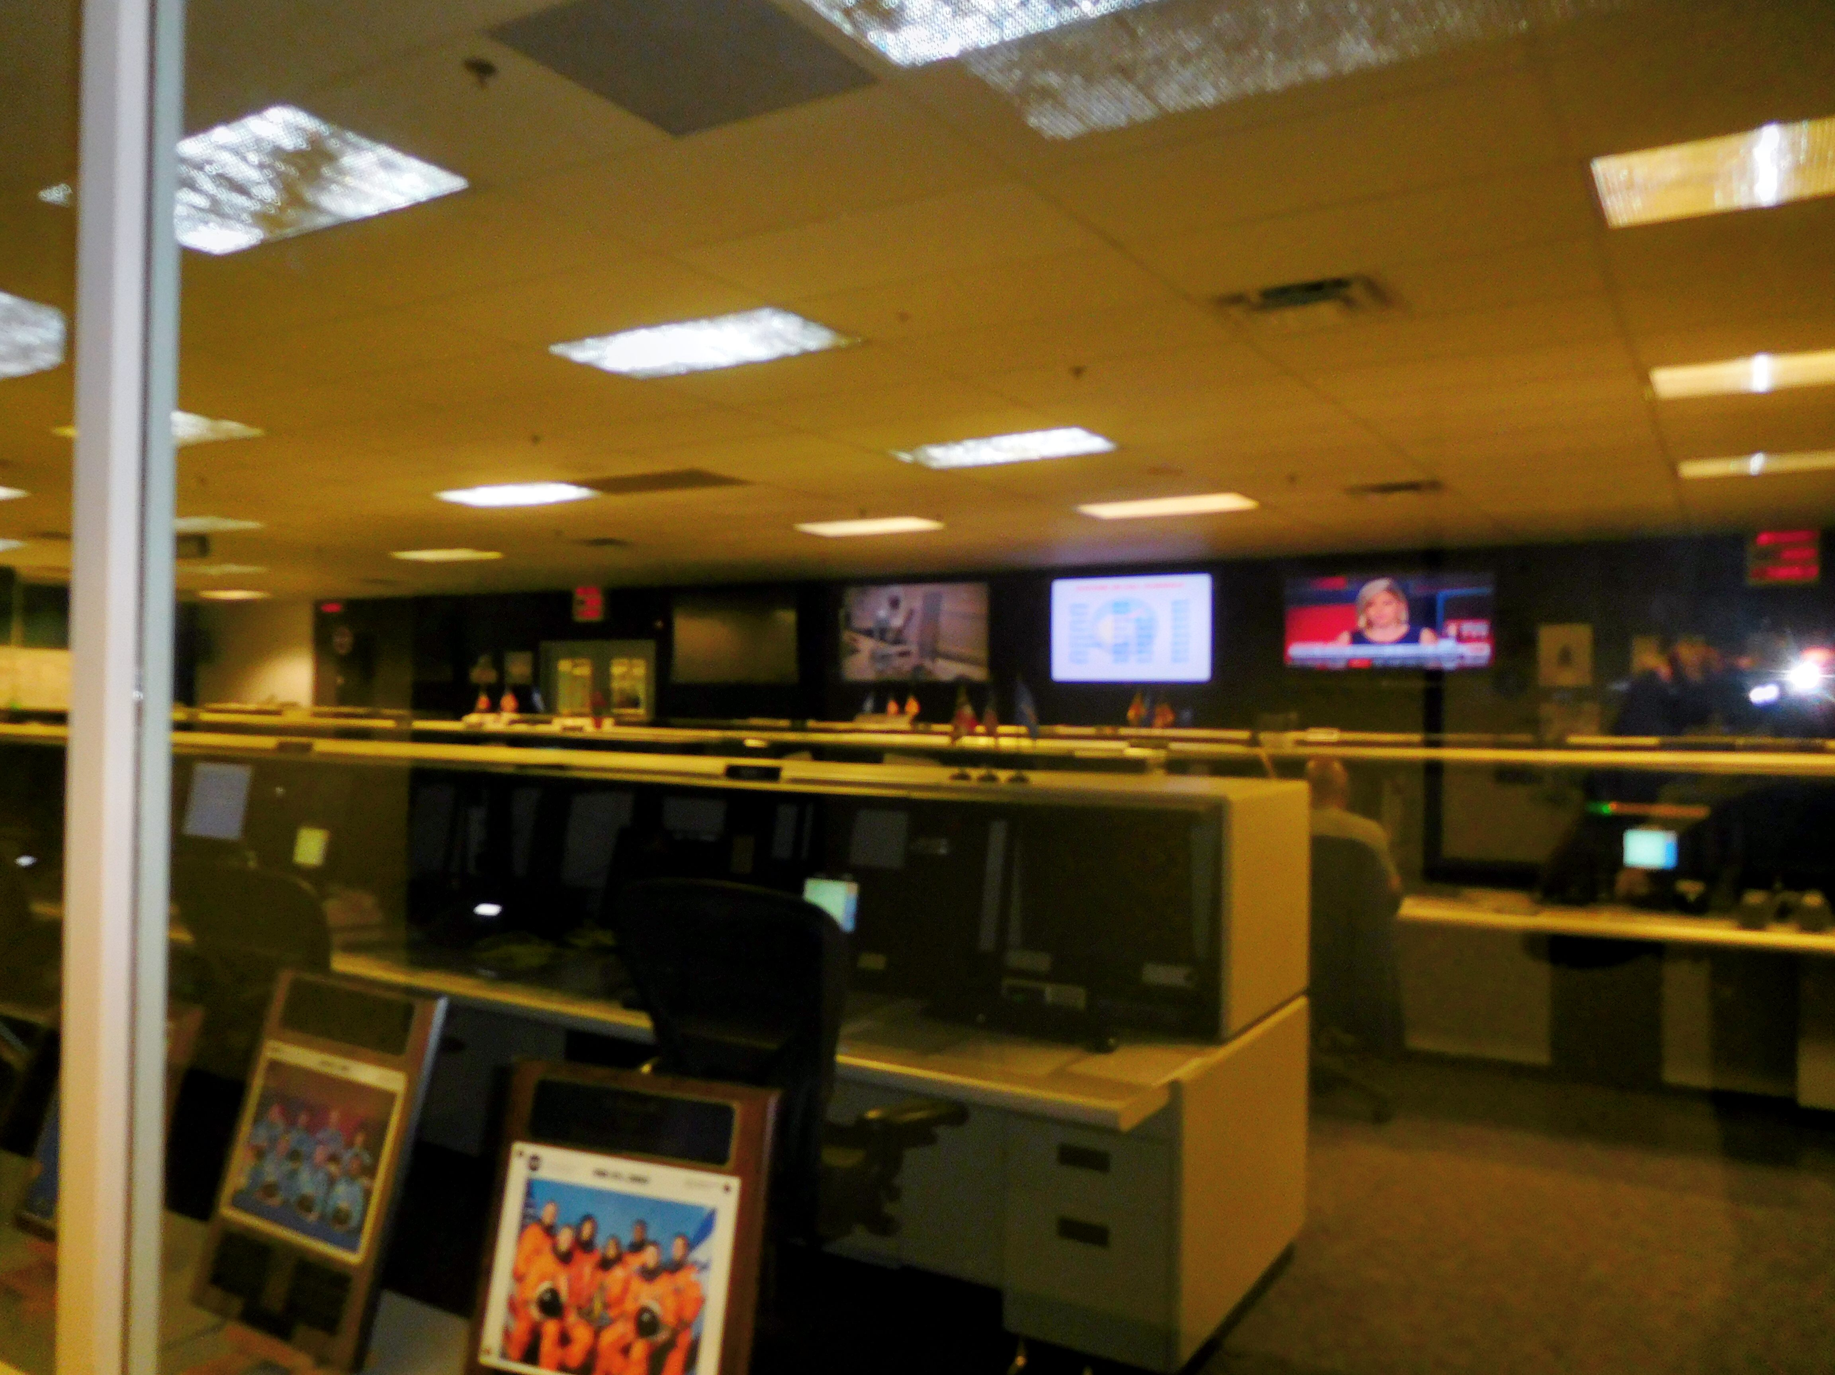
Notes:
NASA Communications center

Slide 34
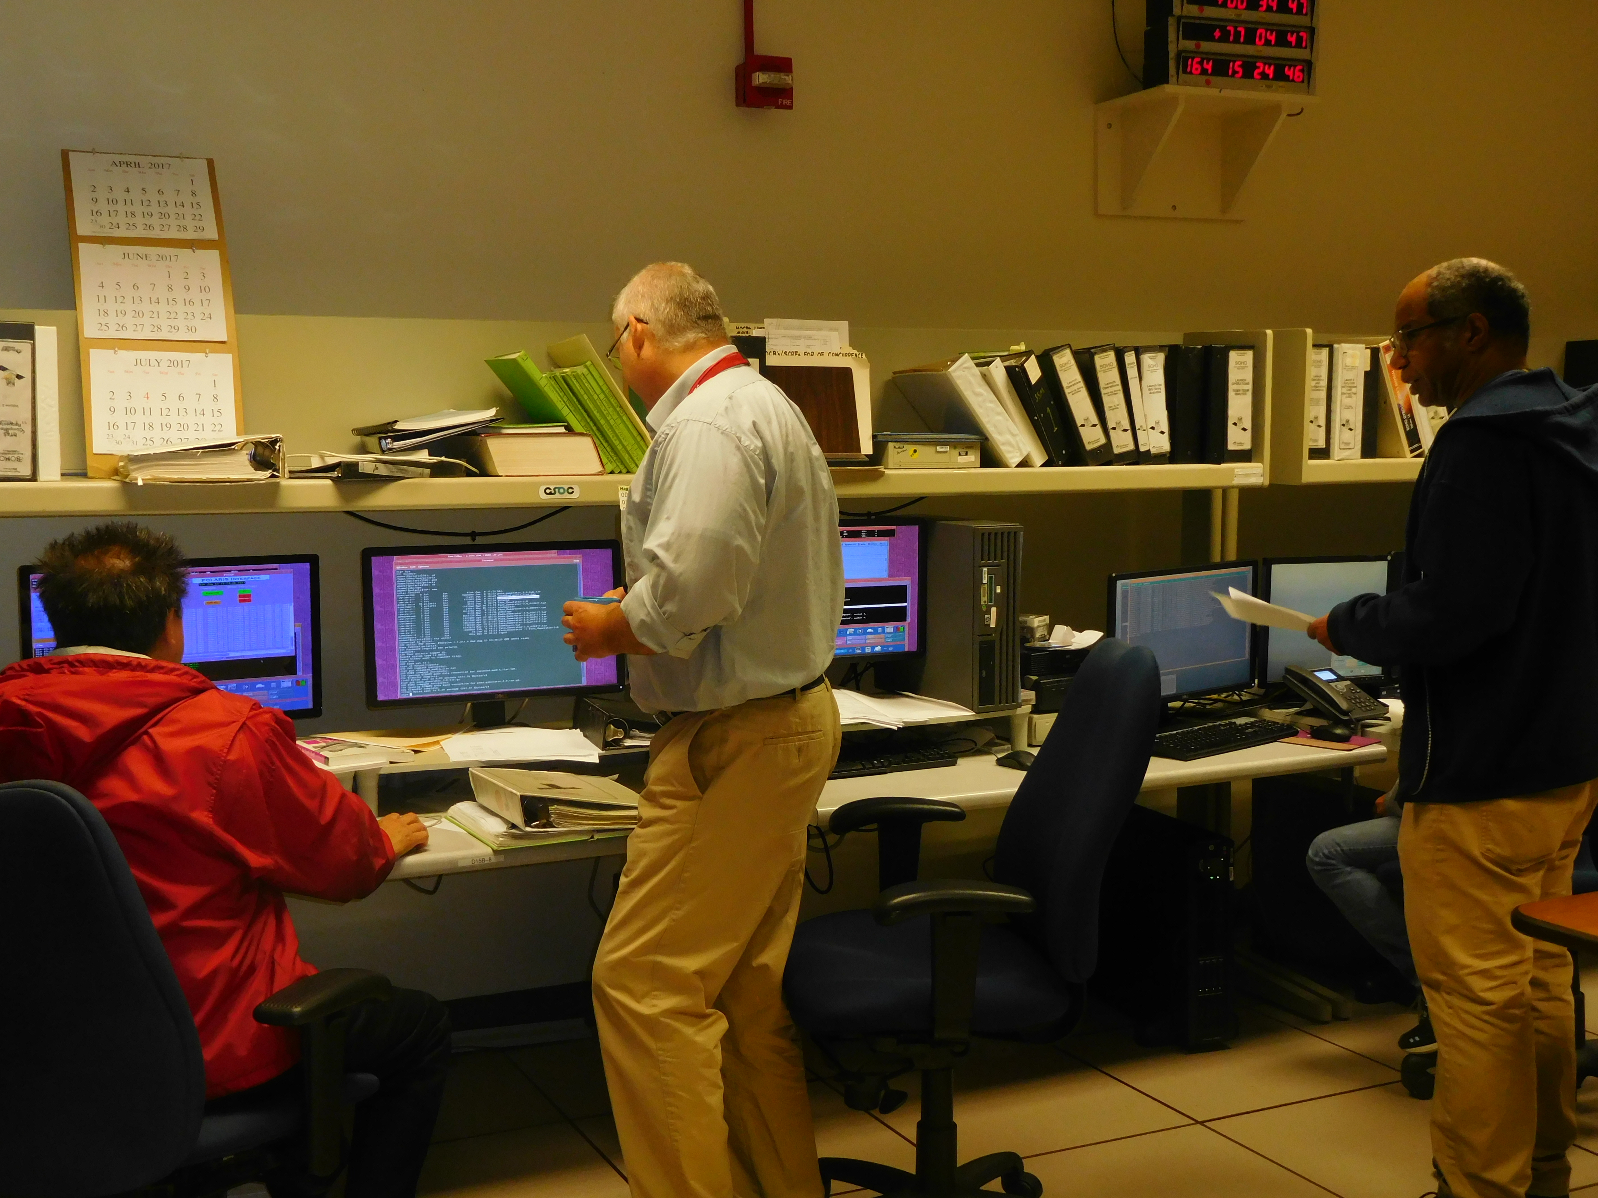
Notes:
Mission Control Center with the Flight Operations Team

Slide 35
Observatory Testing
The testing process is for all the systems, both software and hardware which includes the communications link being used
Various forms for the tests
  Thermal Vacuum Chamber
  Vibration Chamber
  Acoustics Chamber
  Space Environment Chamber
Clean Room Tent
  The observatory is put together
ElectroMagnetic Interference (EMI) testing done on both the observatory equipment and the spacecraft and also done after the observatory is “mated” to the spacecraft
“Test as you would fly and fly as you tested”

Slide 36
Integration Testing
While the instrument(s) are in the thermal vacuum chamber testing is performed by the instrument team and then other tests with a communications link to both the SOC and to the MOC are very frequently performed
Testing with all of the instruments after they are integrated into the observatory are continually performed over and over and then retested by the SOC and the MOC
The testing between each of the facilities are retested many times
Each of the facilities tests their communications link to the “station(s)” which will be used to support the mission, including the backup station(s) if requested by the mission

Slide 37
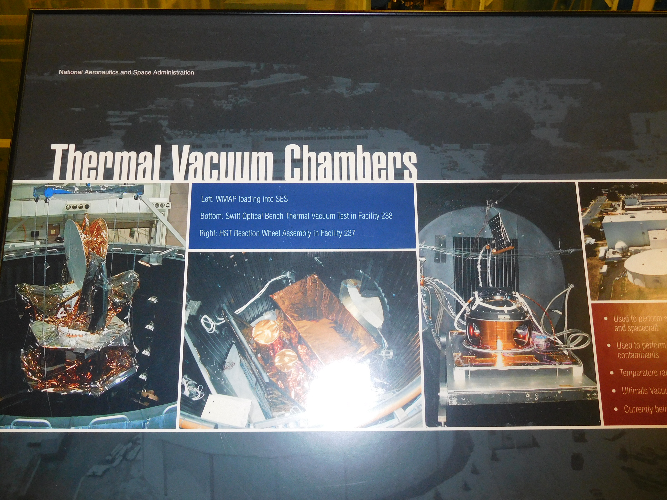

Slide 38
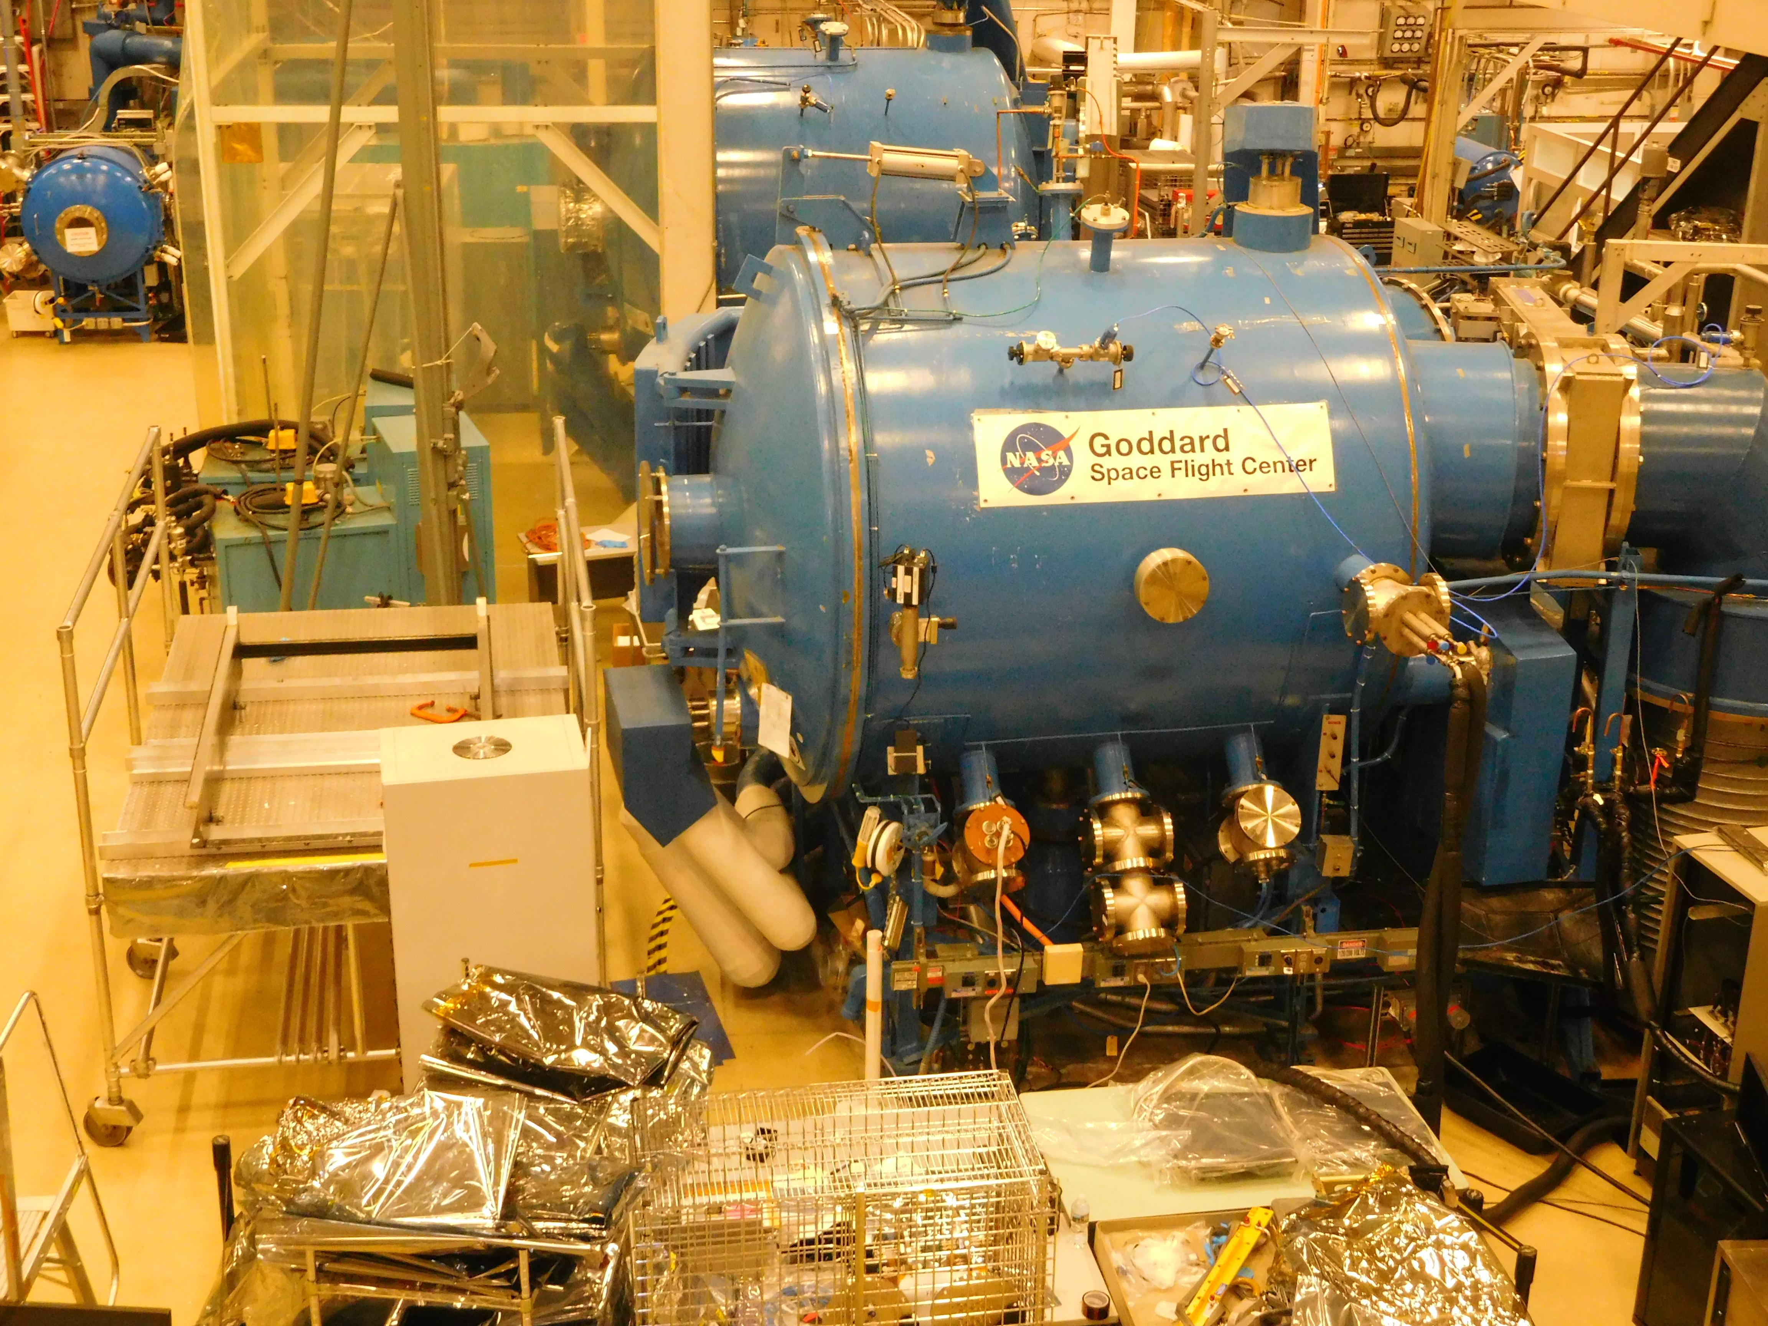
Notes:
Thermal Vac Chamber for instrument testing

Slide 39
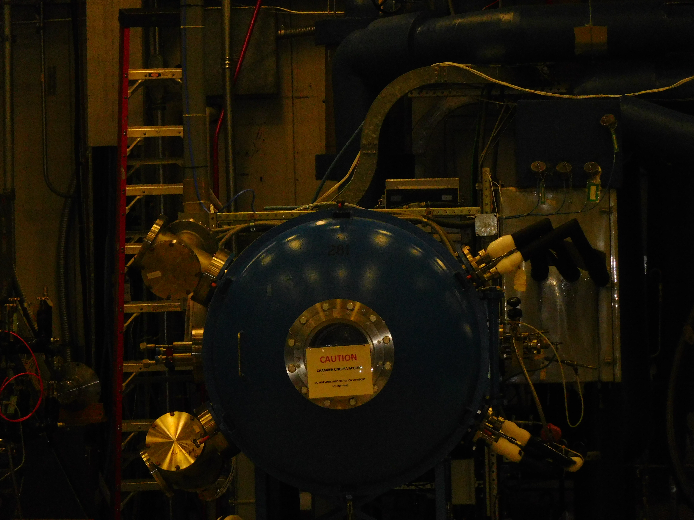
Notes:
Smaller thermal vac chamber for testing

Slide 40
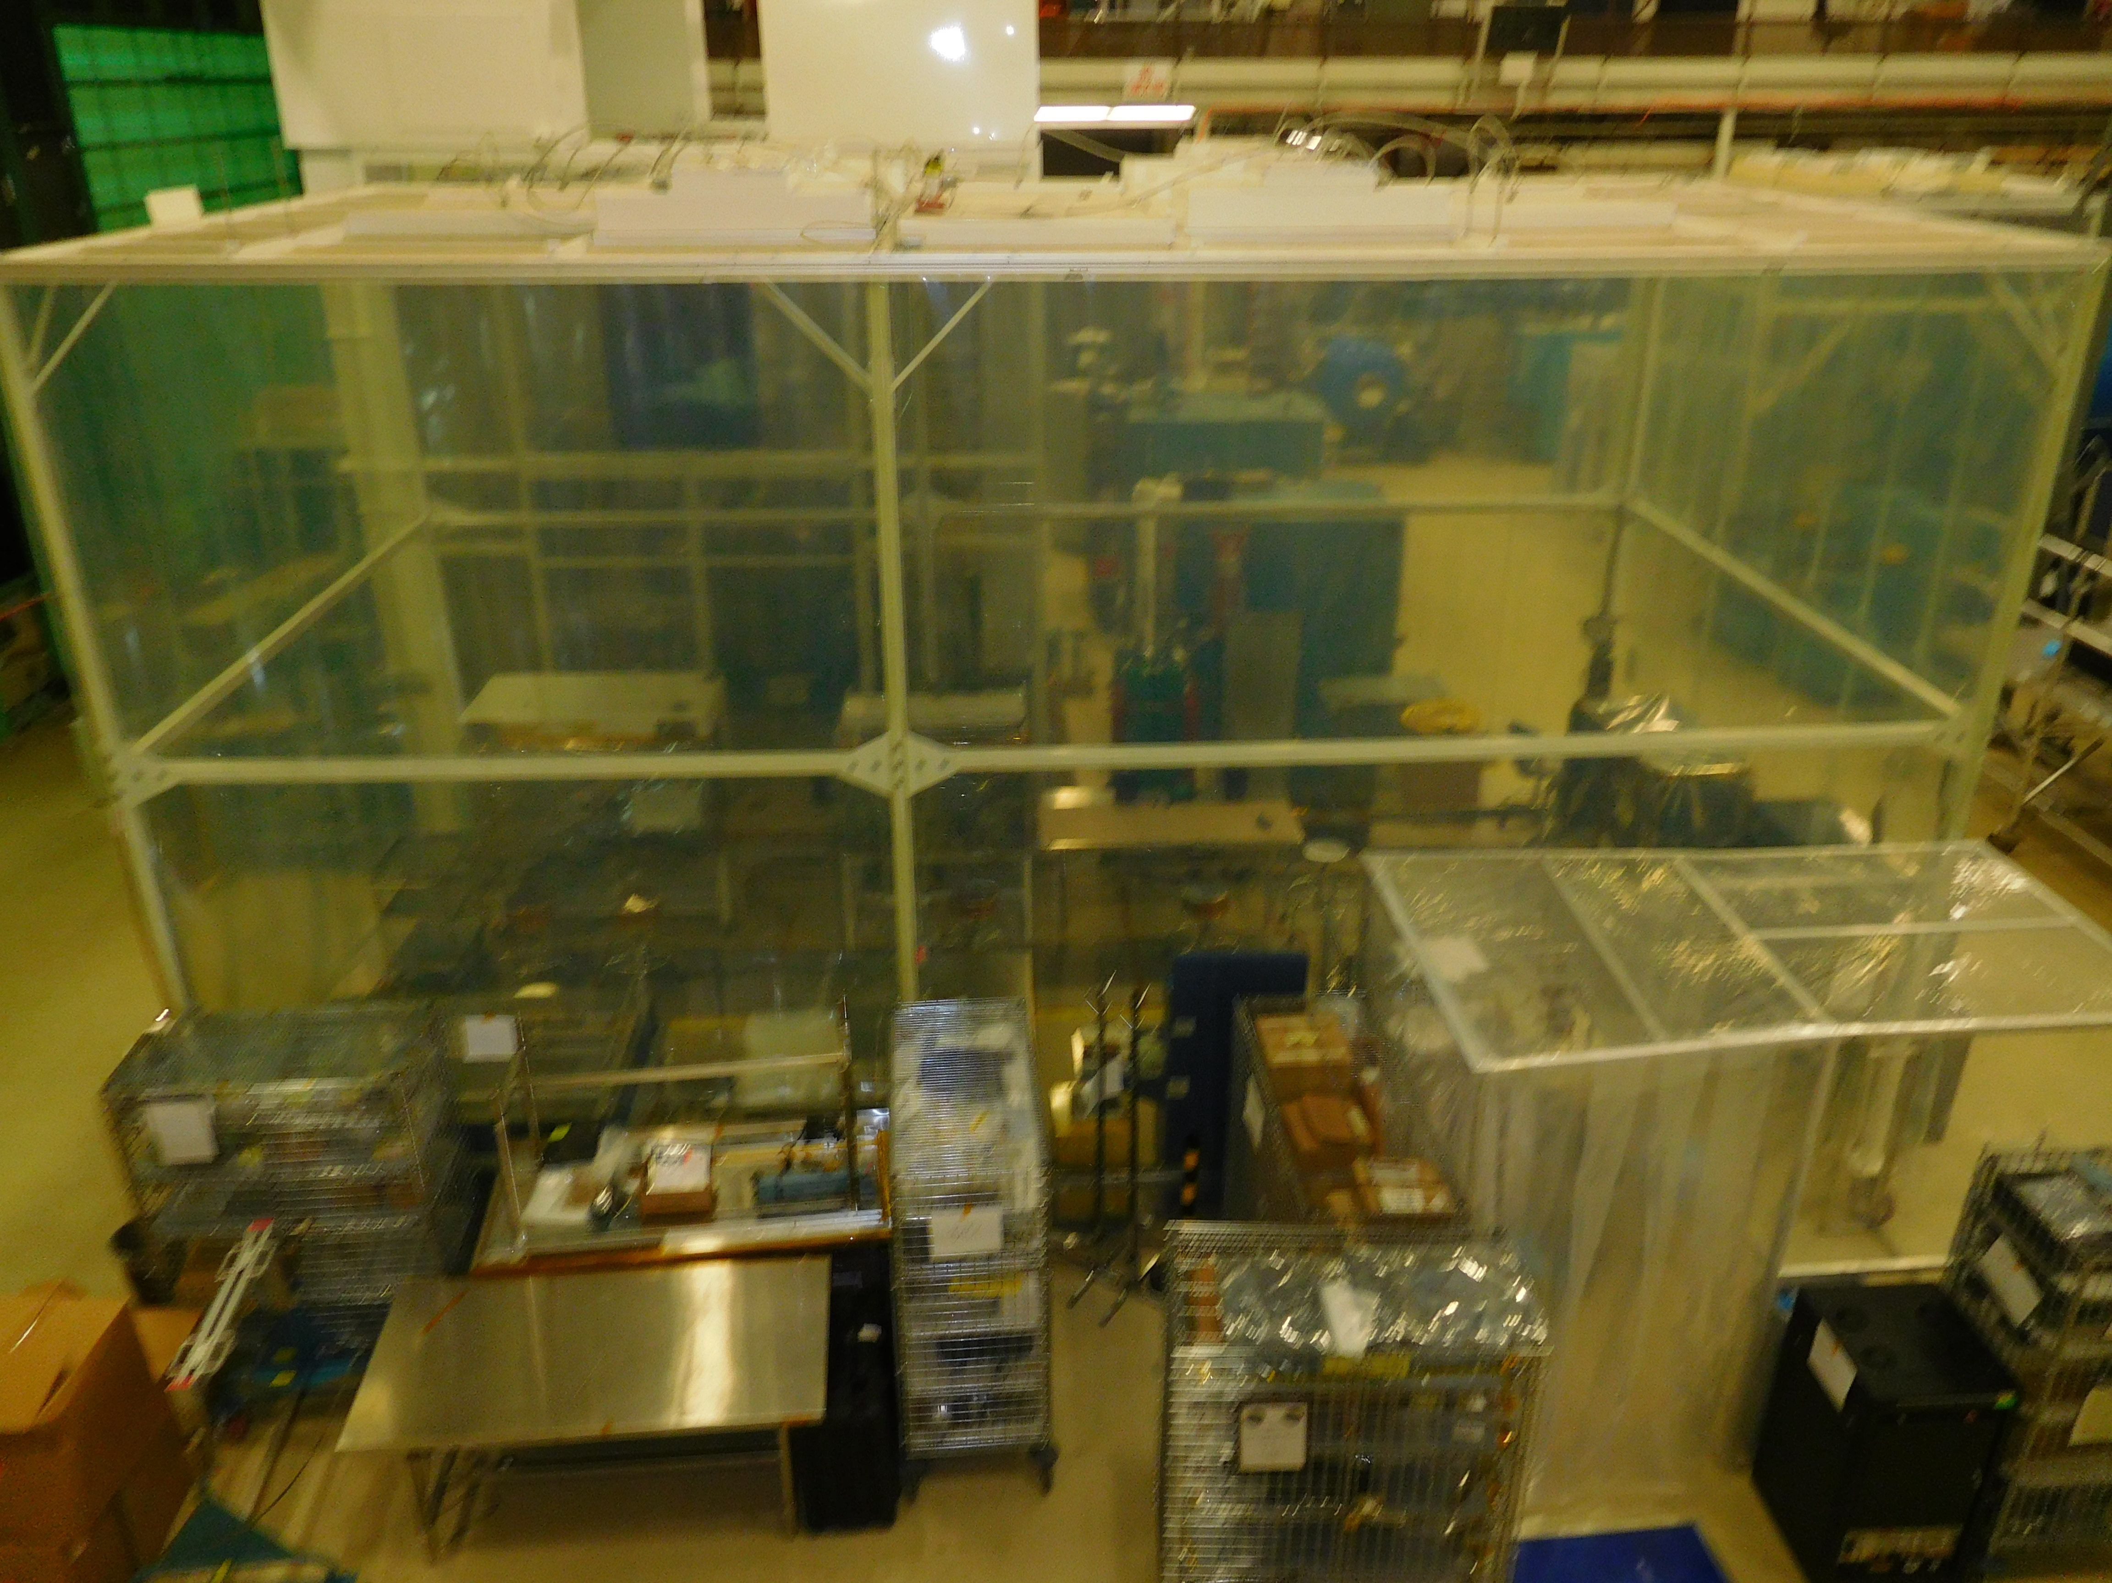
Notes:
Clean room tent for assembly

Slide 41
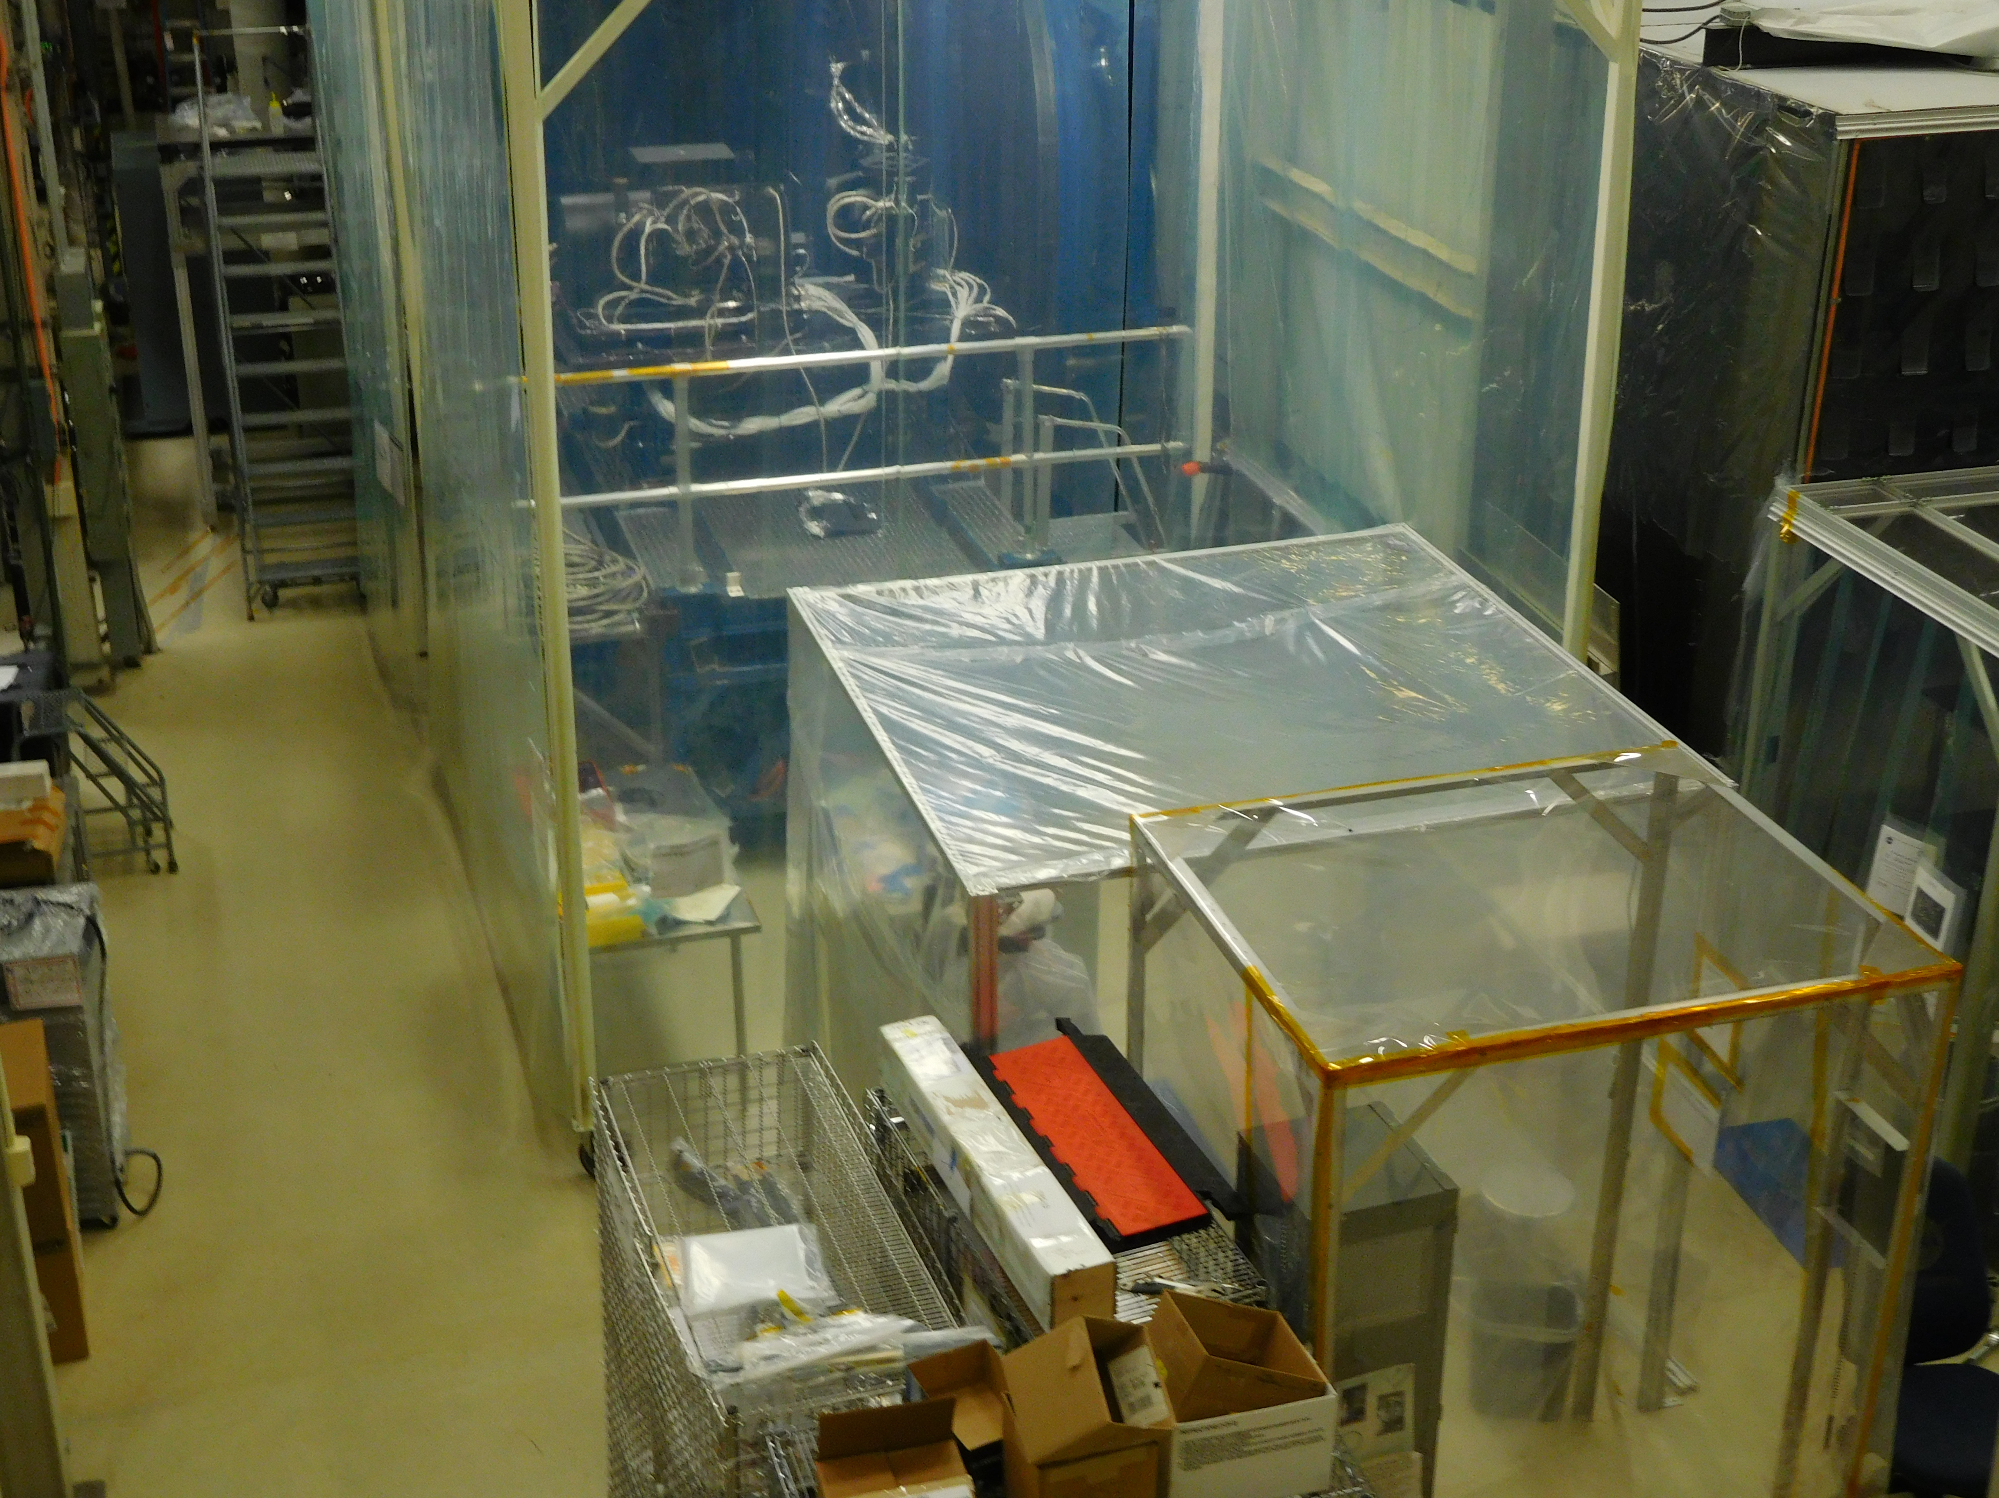
Notes:
Smaller clean room tent

Slide 42
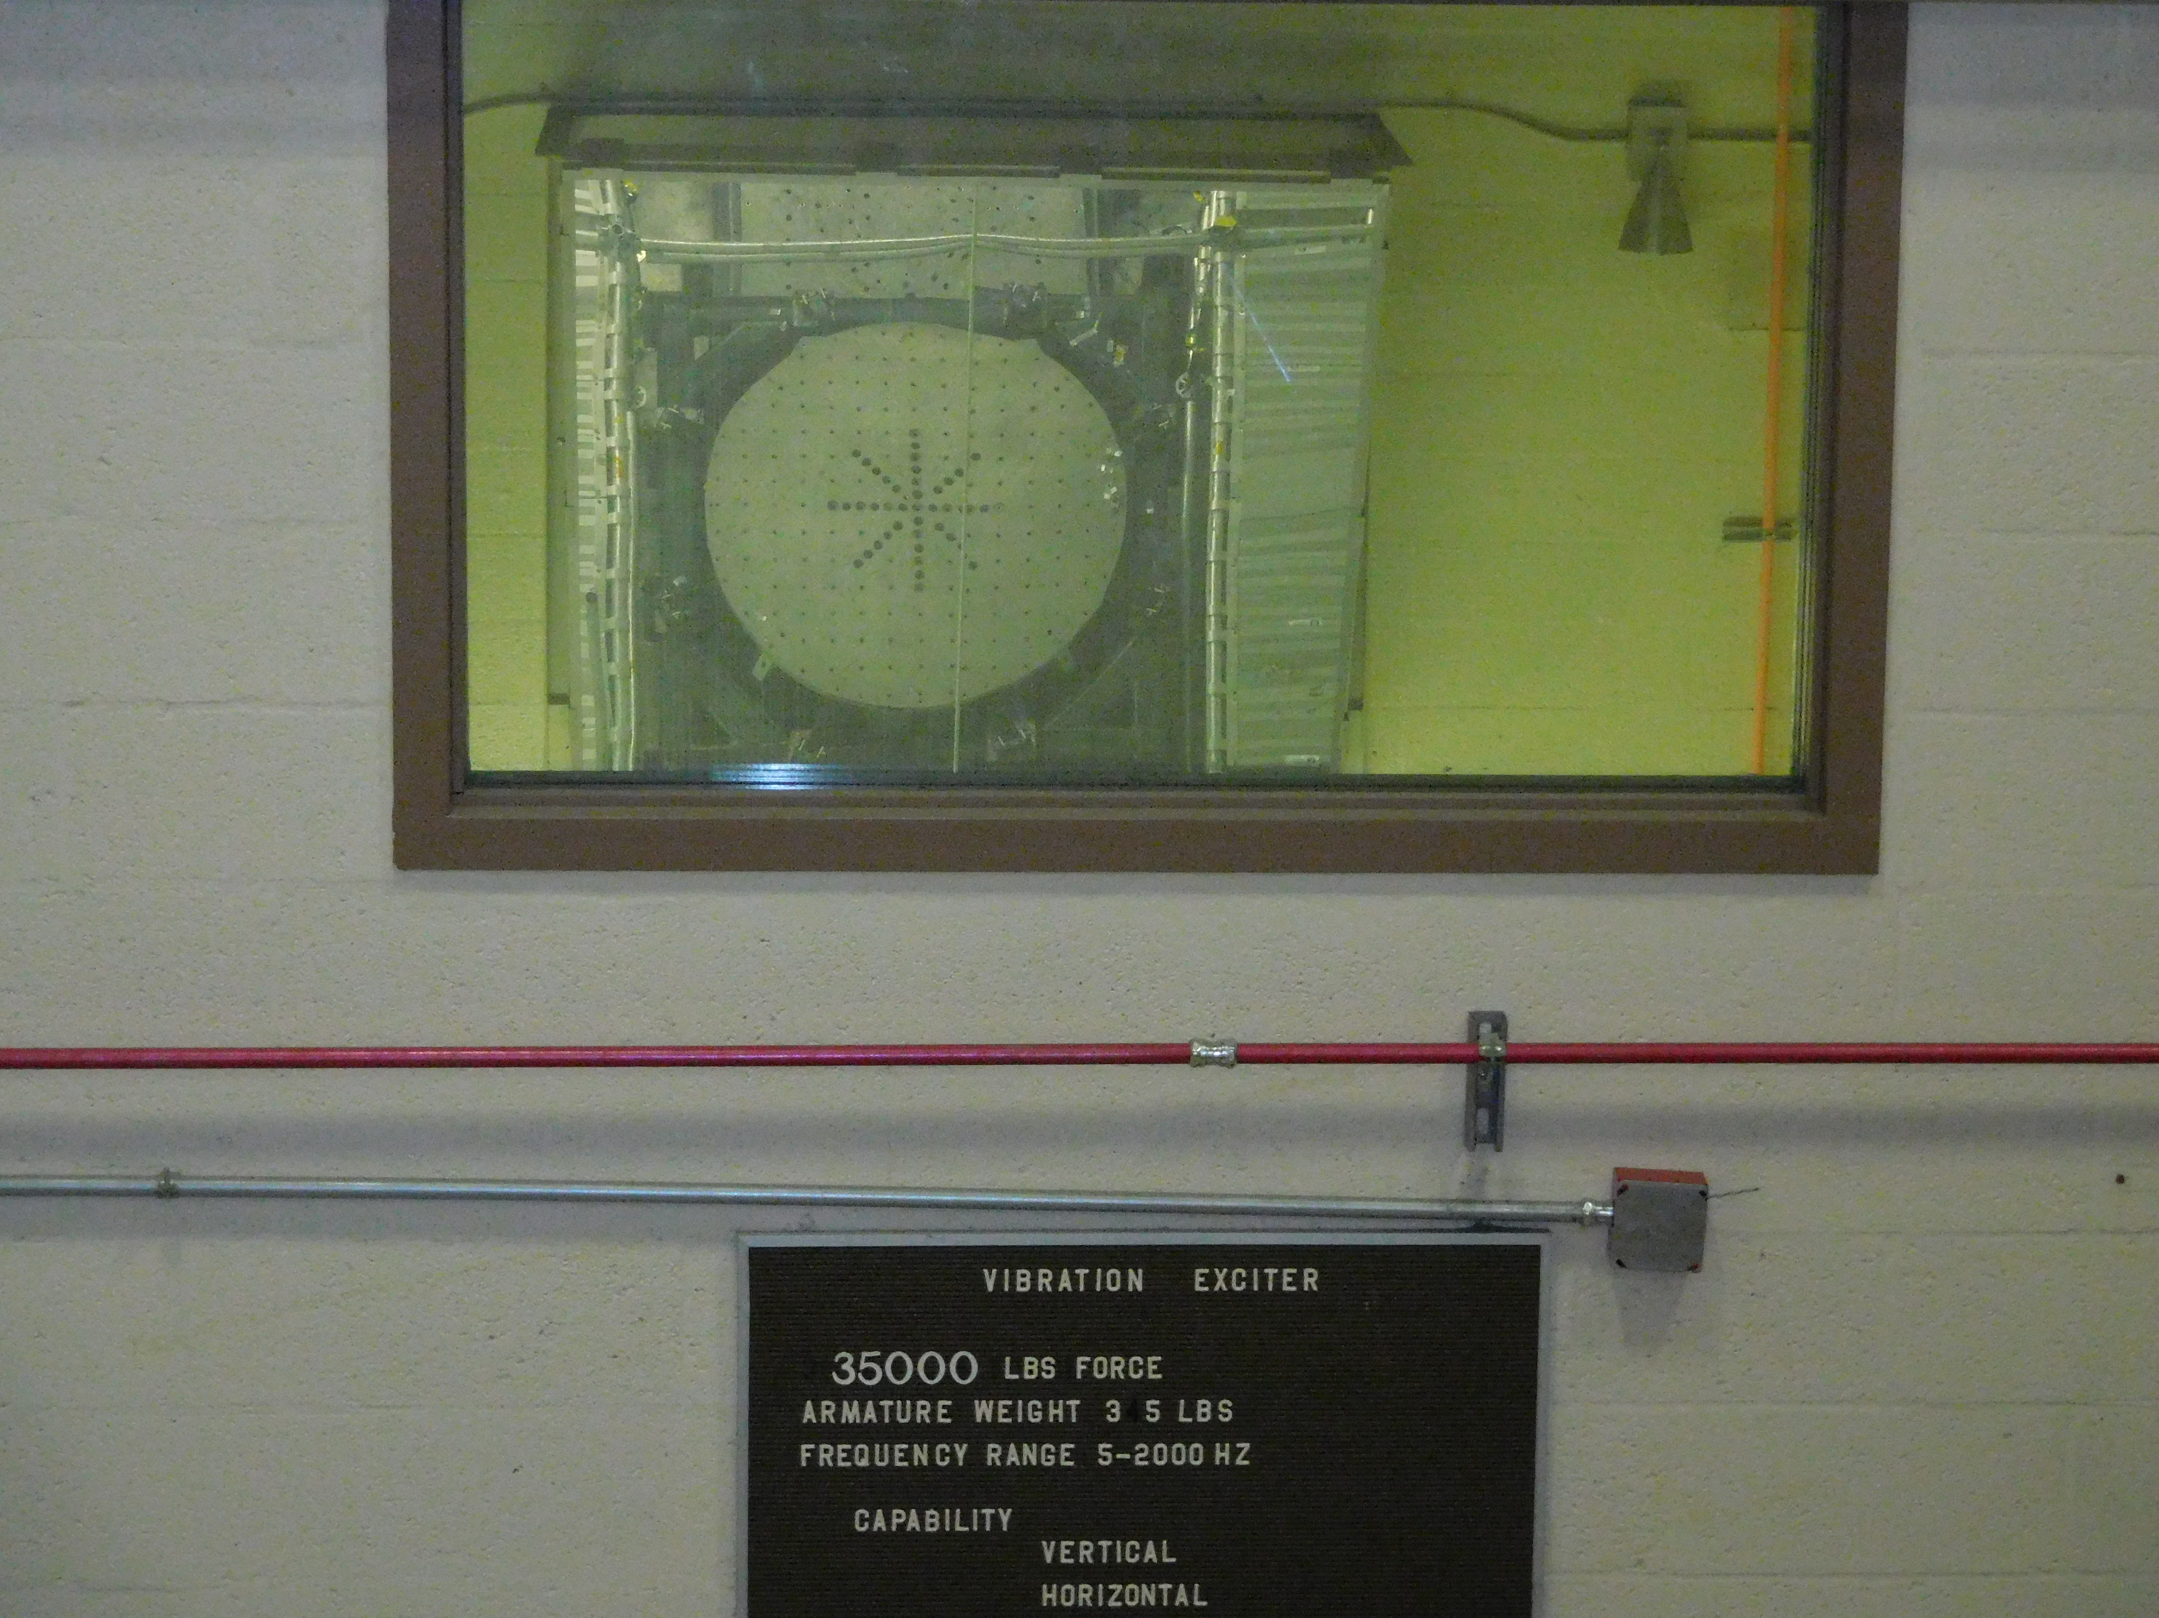
Notes:
Vibration chamber for testing parts, instruments

Slide 43
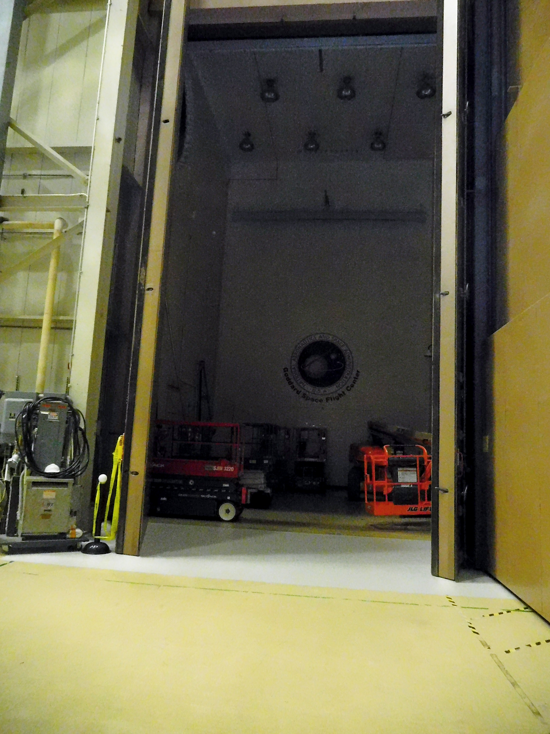
Notes:
Acoustic chamber – very tall can hold a small spacecraft or the second stage of an atlas rocket

Slide 44
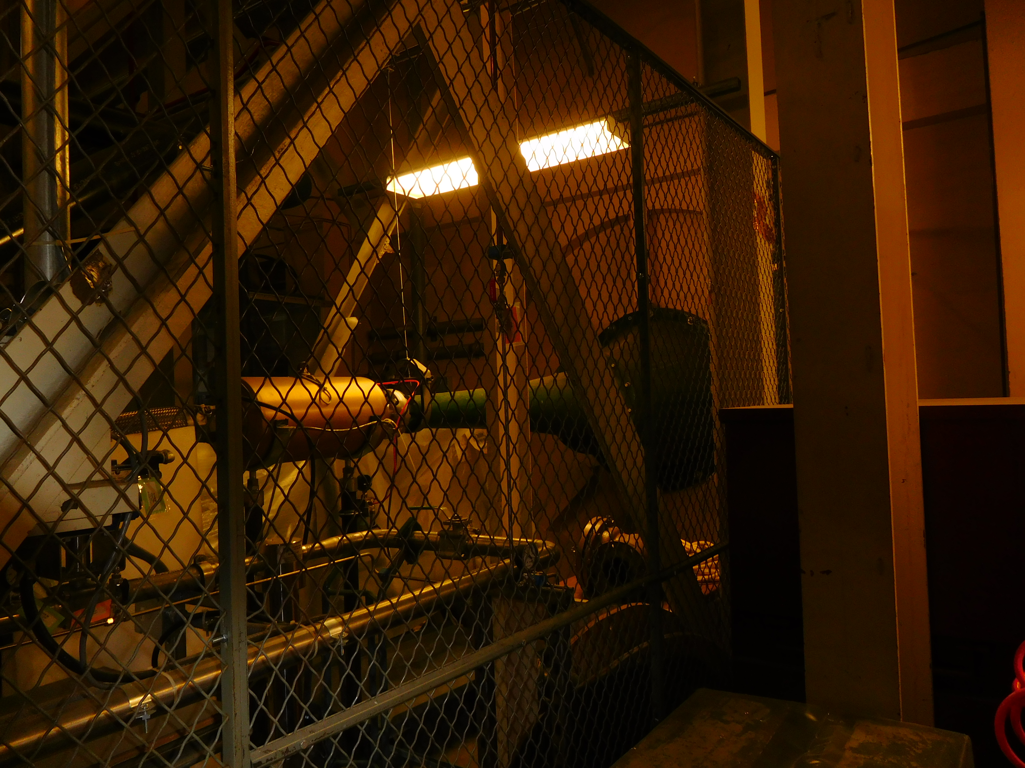
Notes:
One of the smaller horns of the acoustic chamber

Slide 45
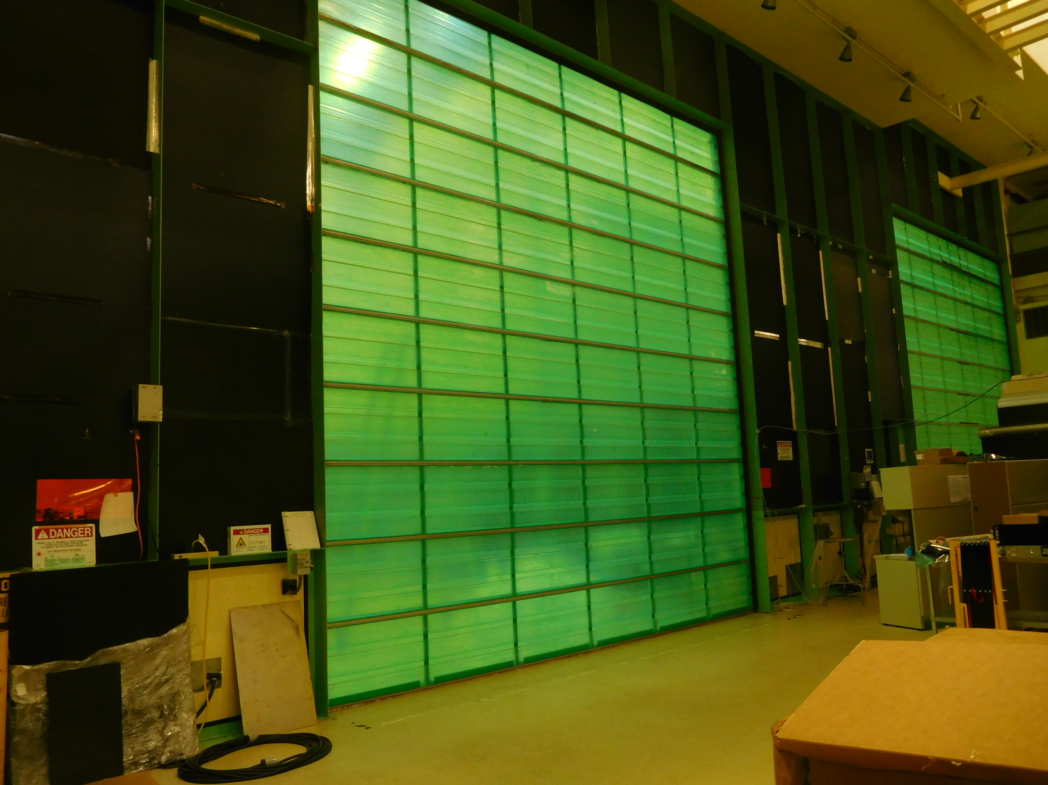
Notes:
A clean room where spacecraft are assembled - this is where the STEREO spacecraft were built

Slide 46
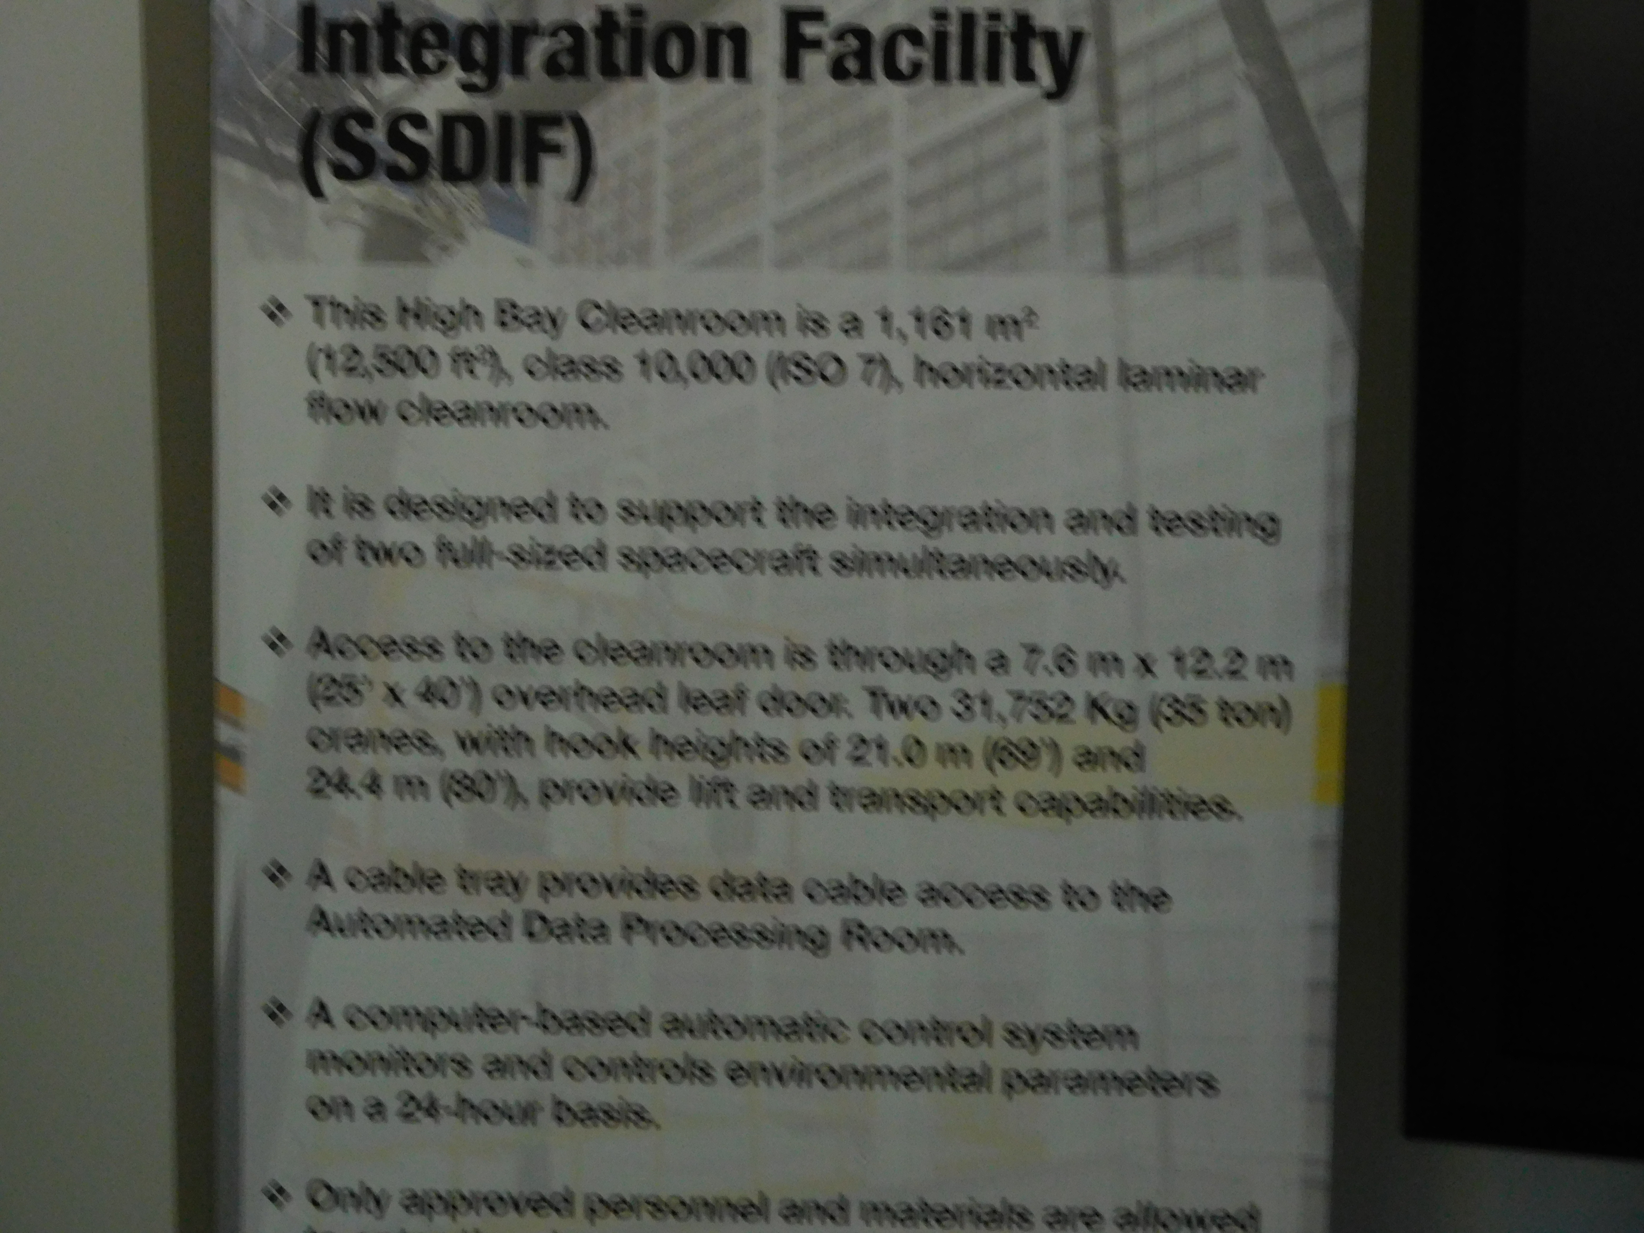

Slide 47
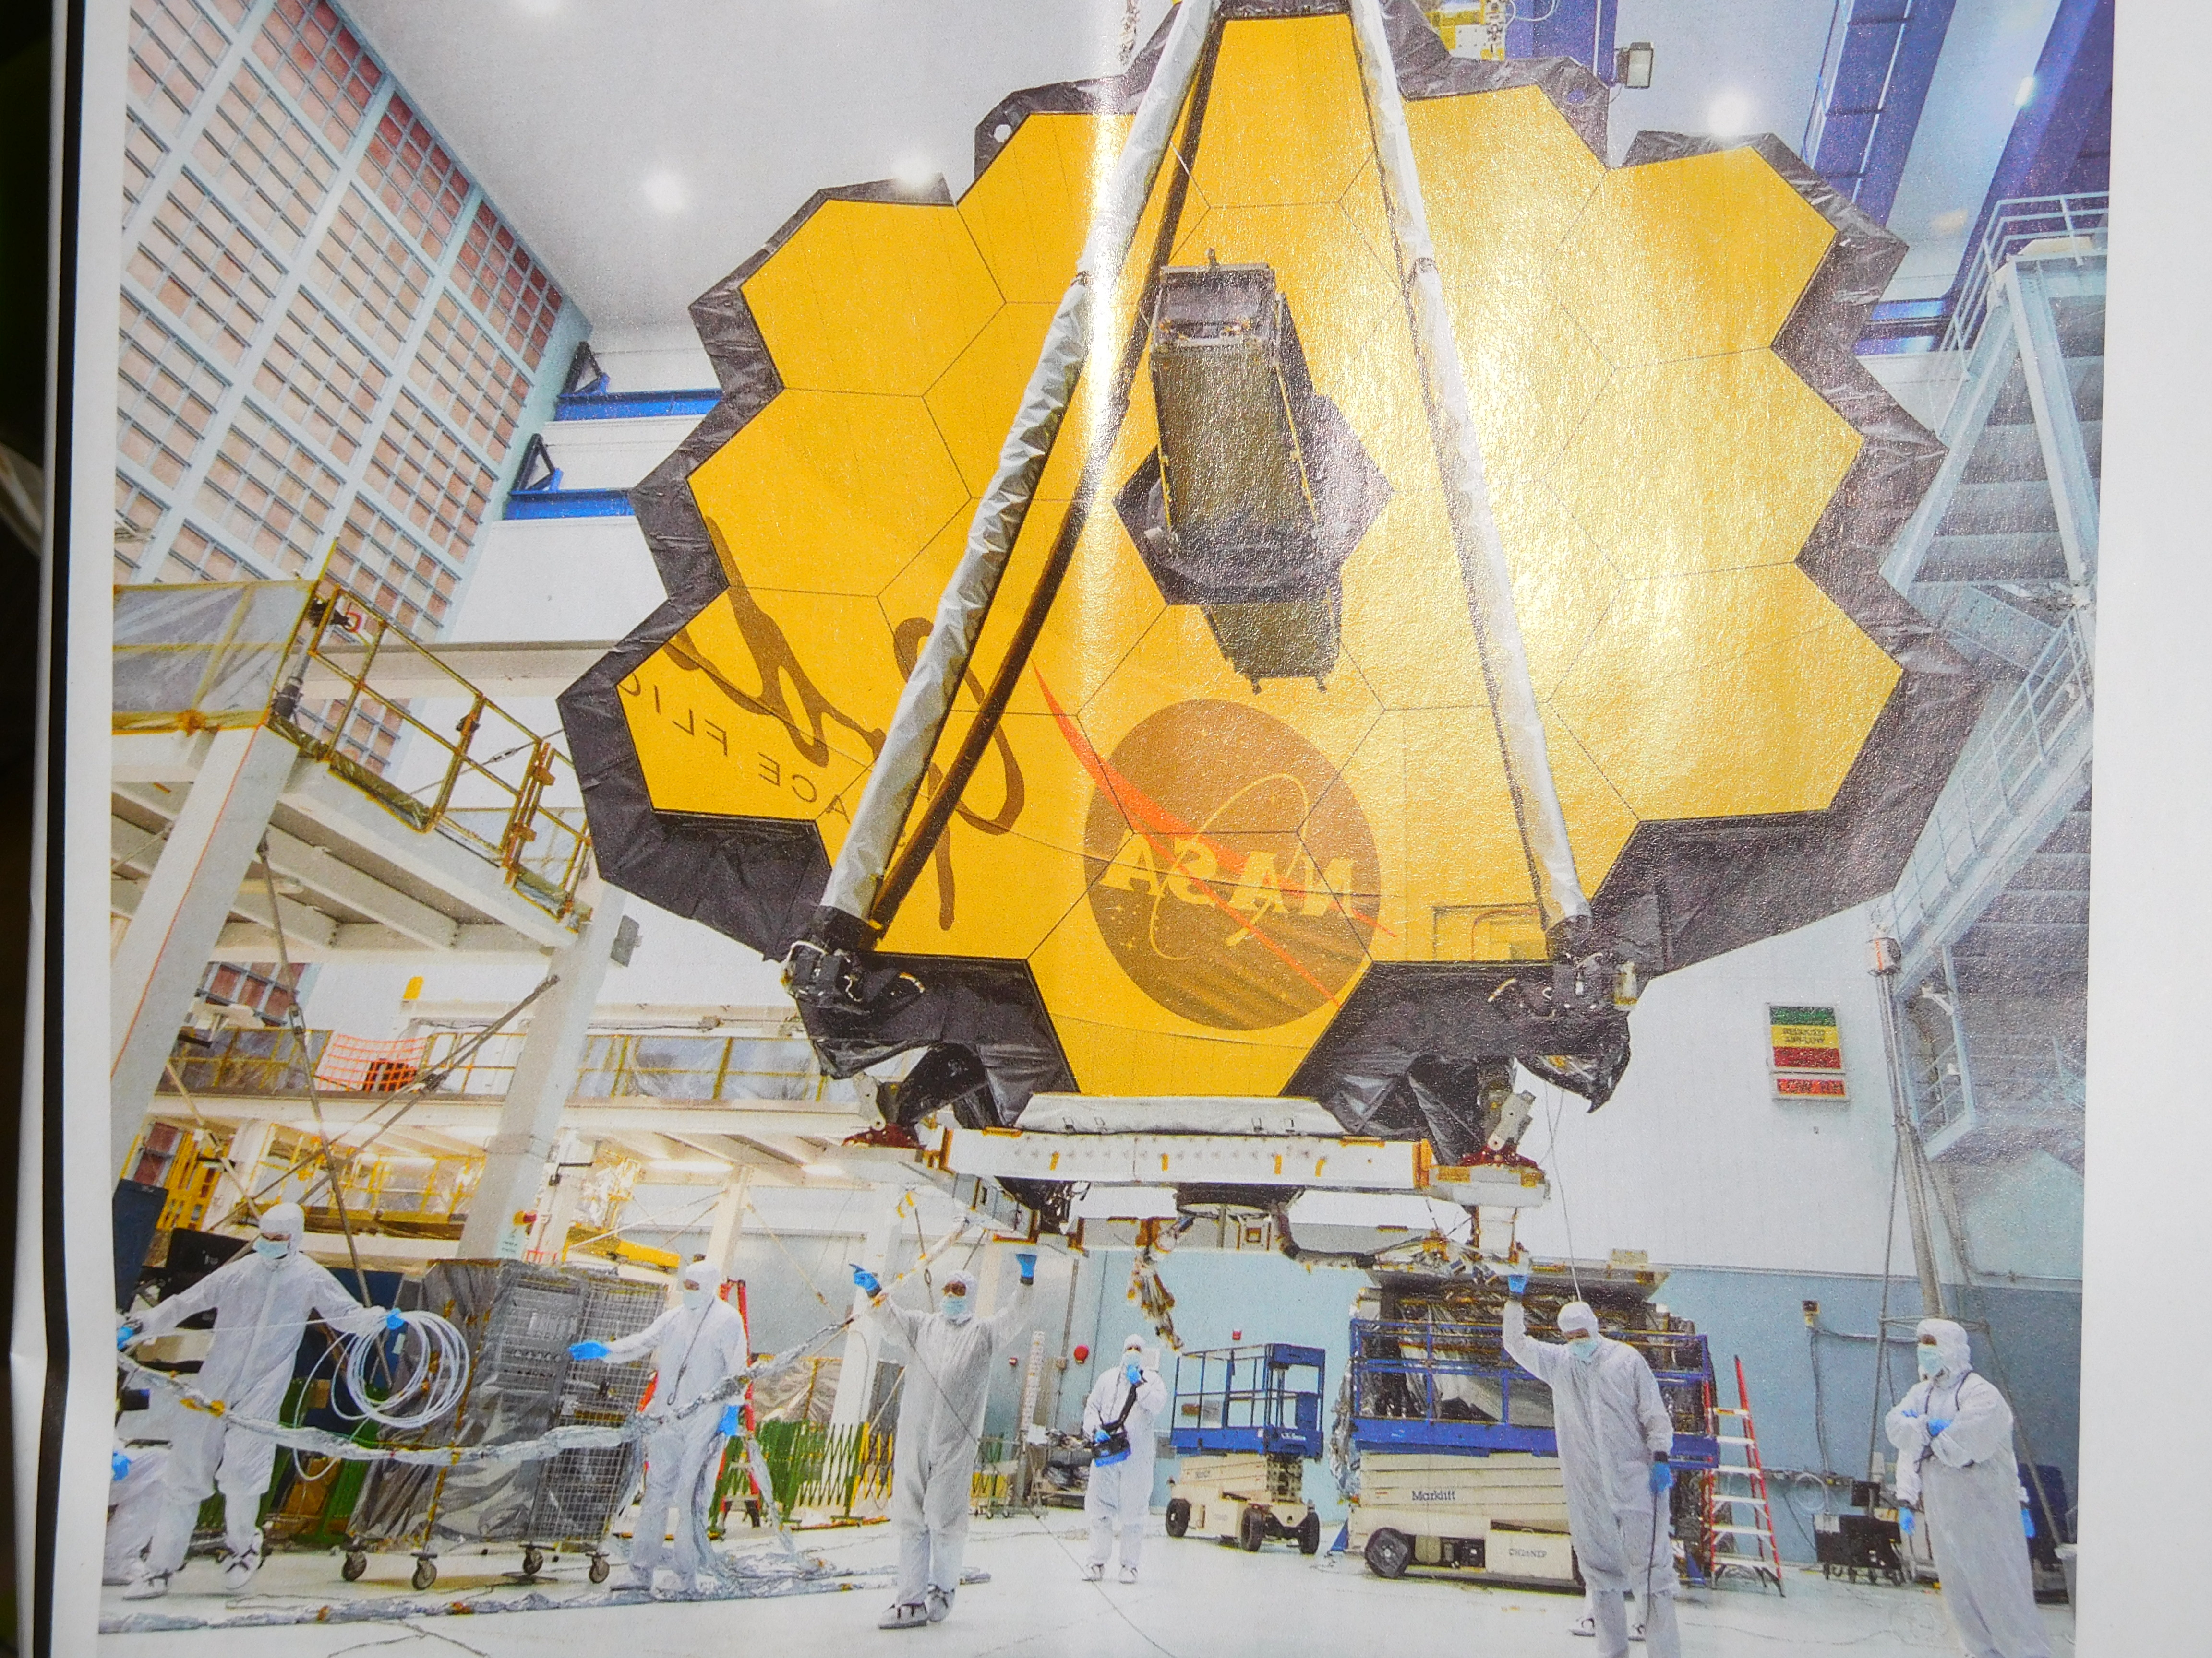
Notes:
The large class 10,000 clean room where the JWST was assembled

Slide 48
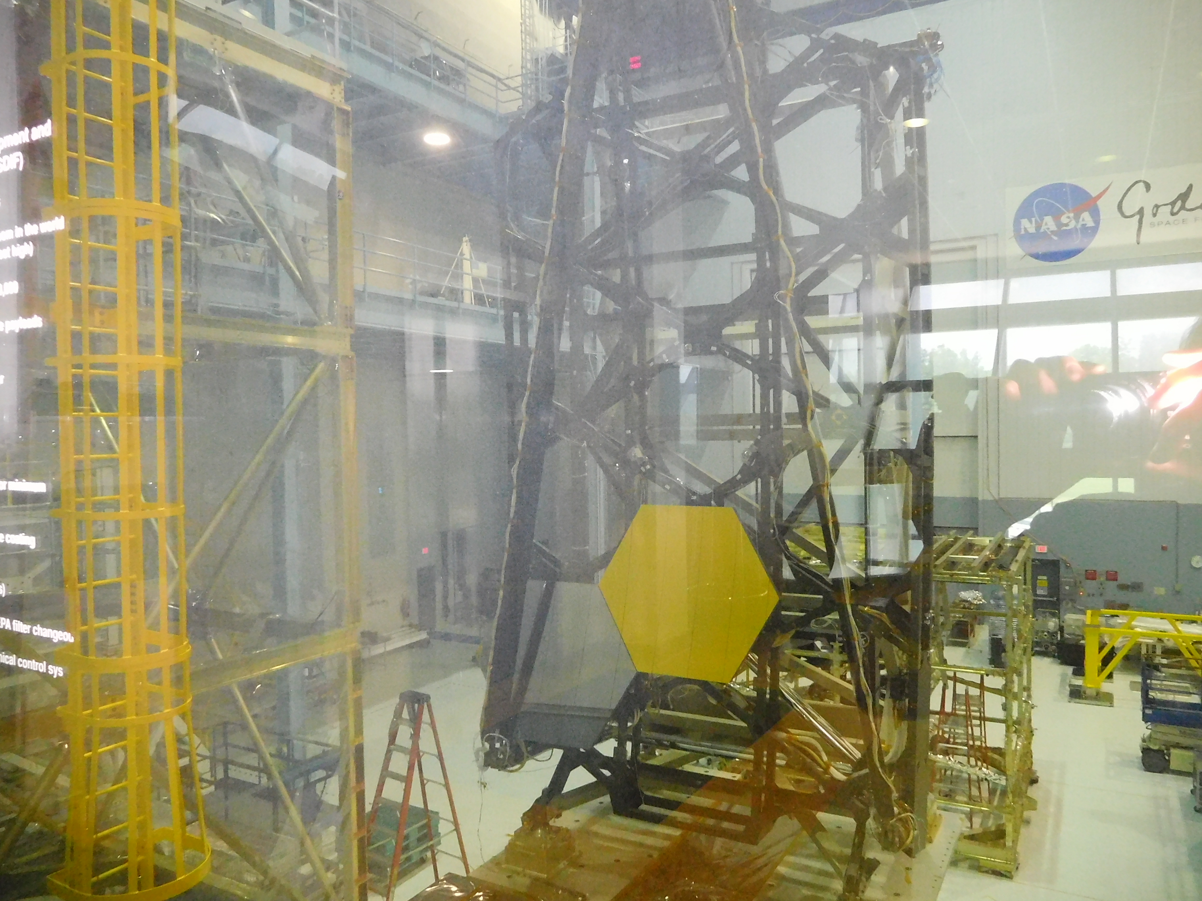
Notes:
The SSDIF after JWST was sent to JSC

Slide 49
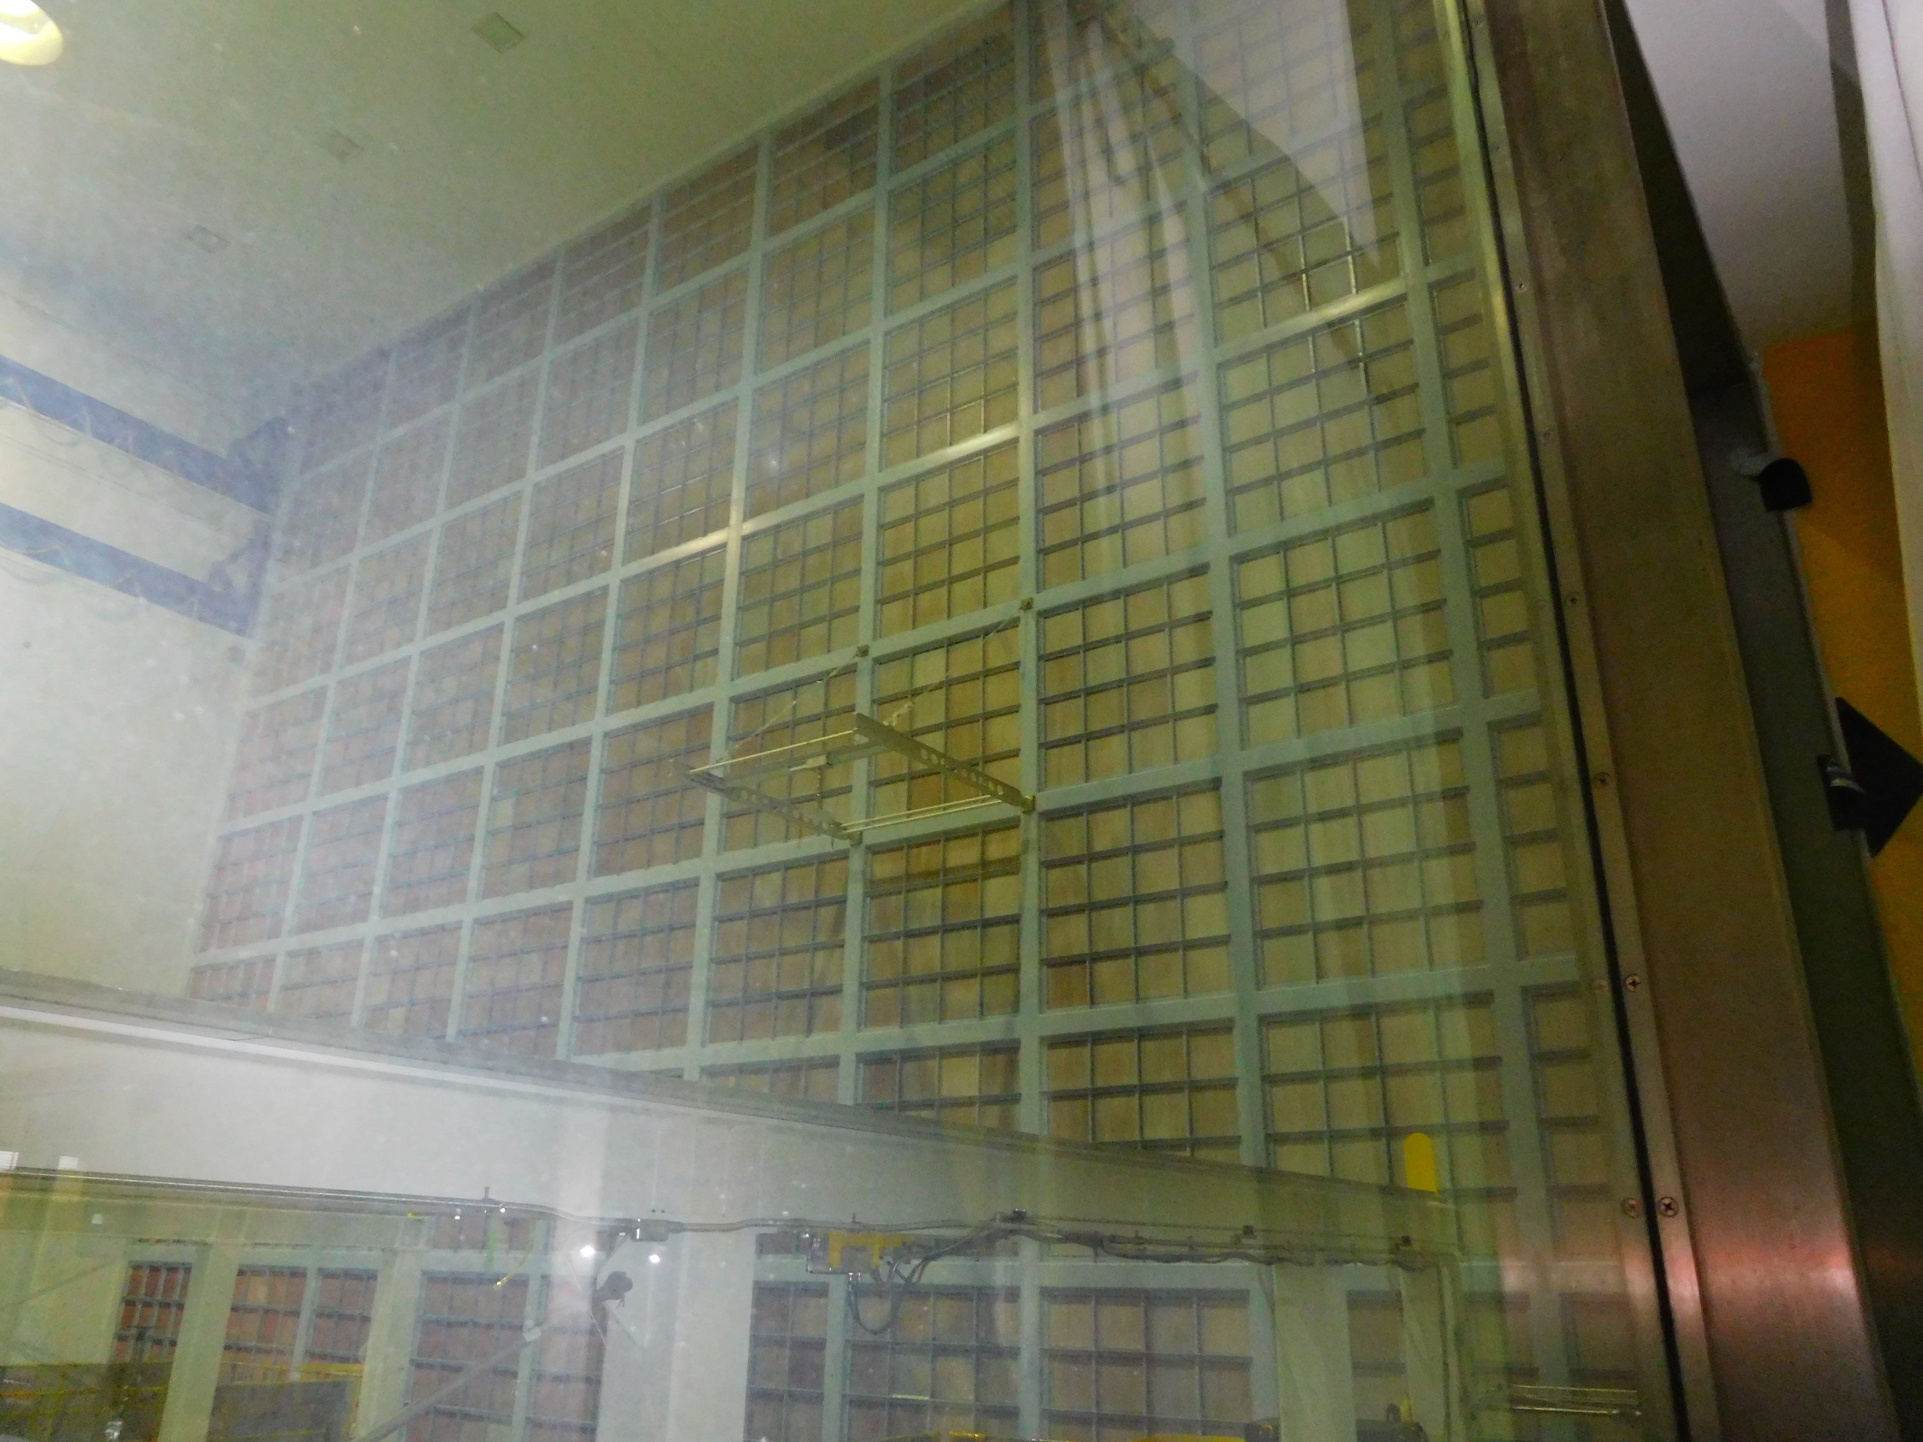
Notes:
The SSDIF HEPA filters

Slide 50
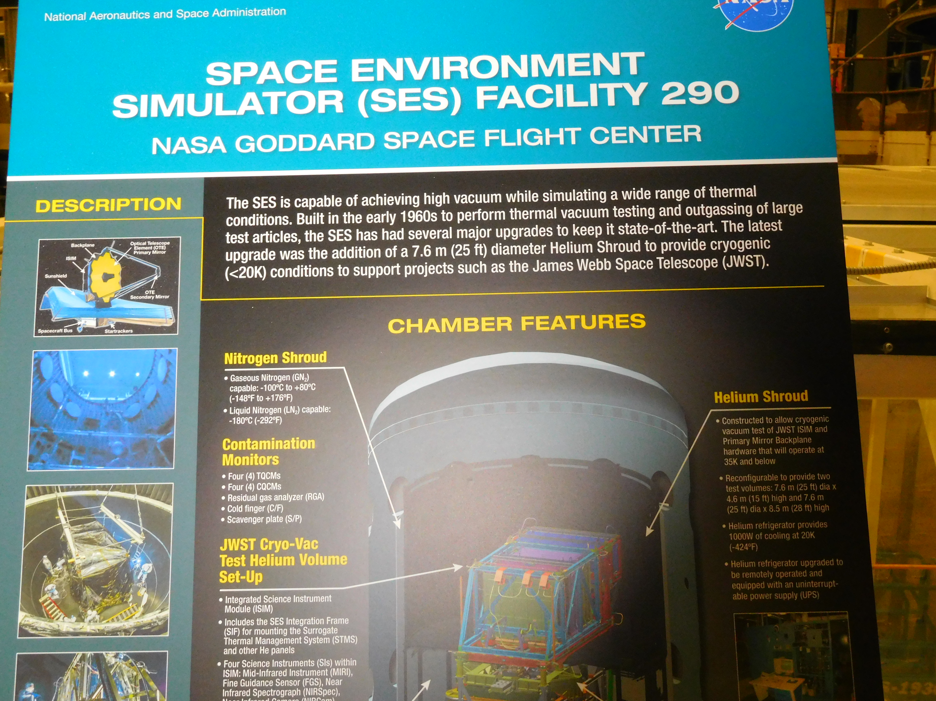
Notes:
The very large chamber where the spacecraft are tested

Slide 51
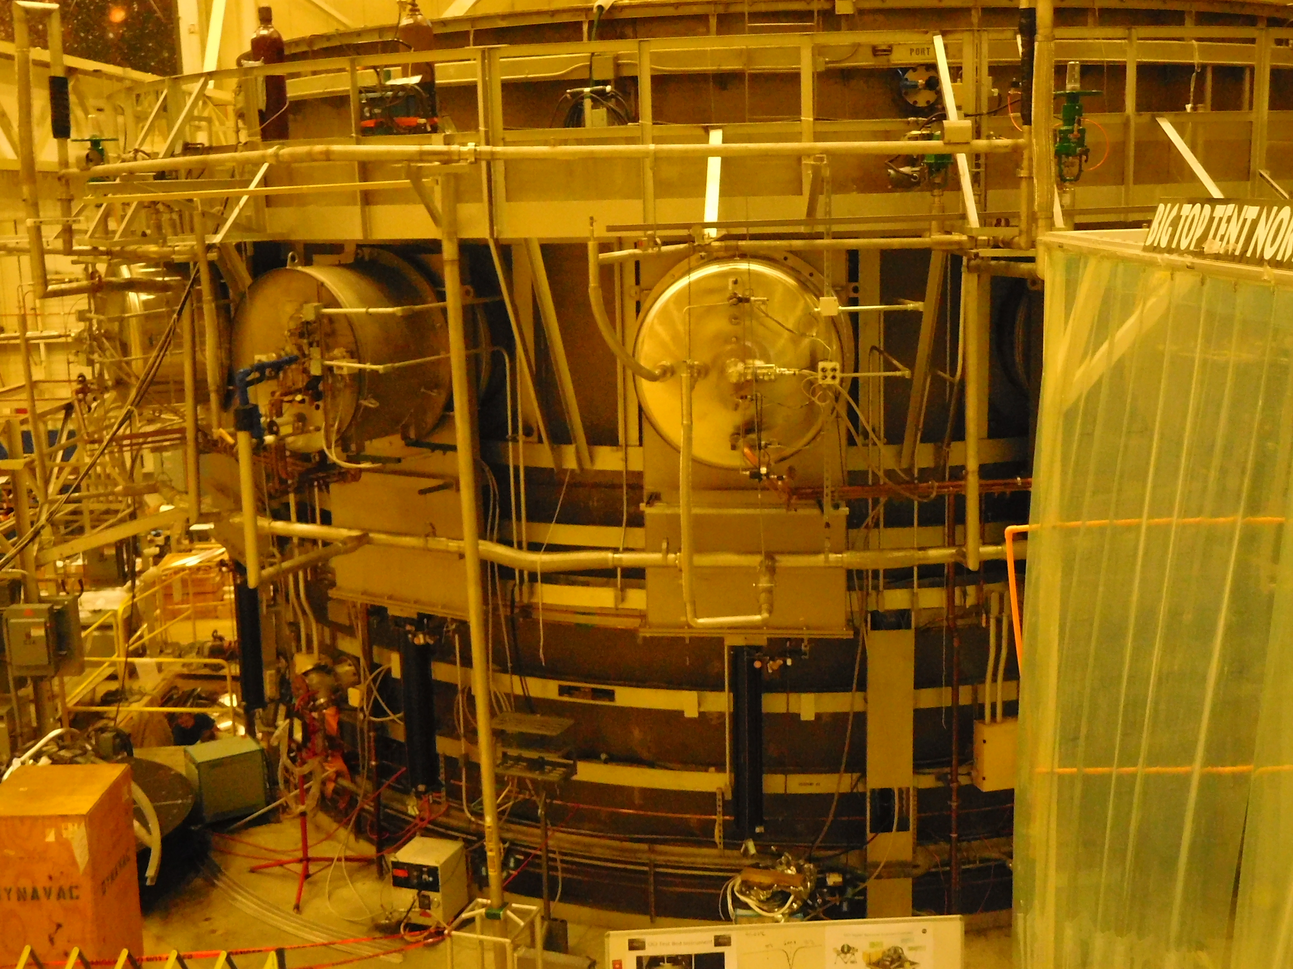
Notes:
The upper half of the SES – the lower half is below the floor

Slide 52
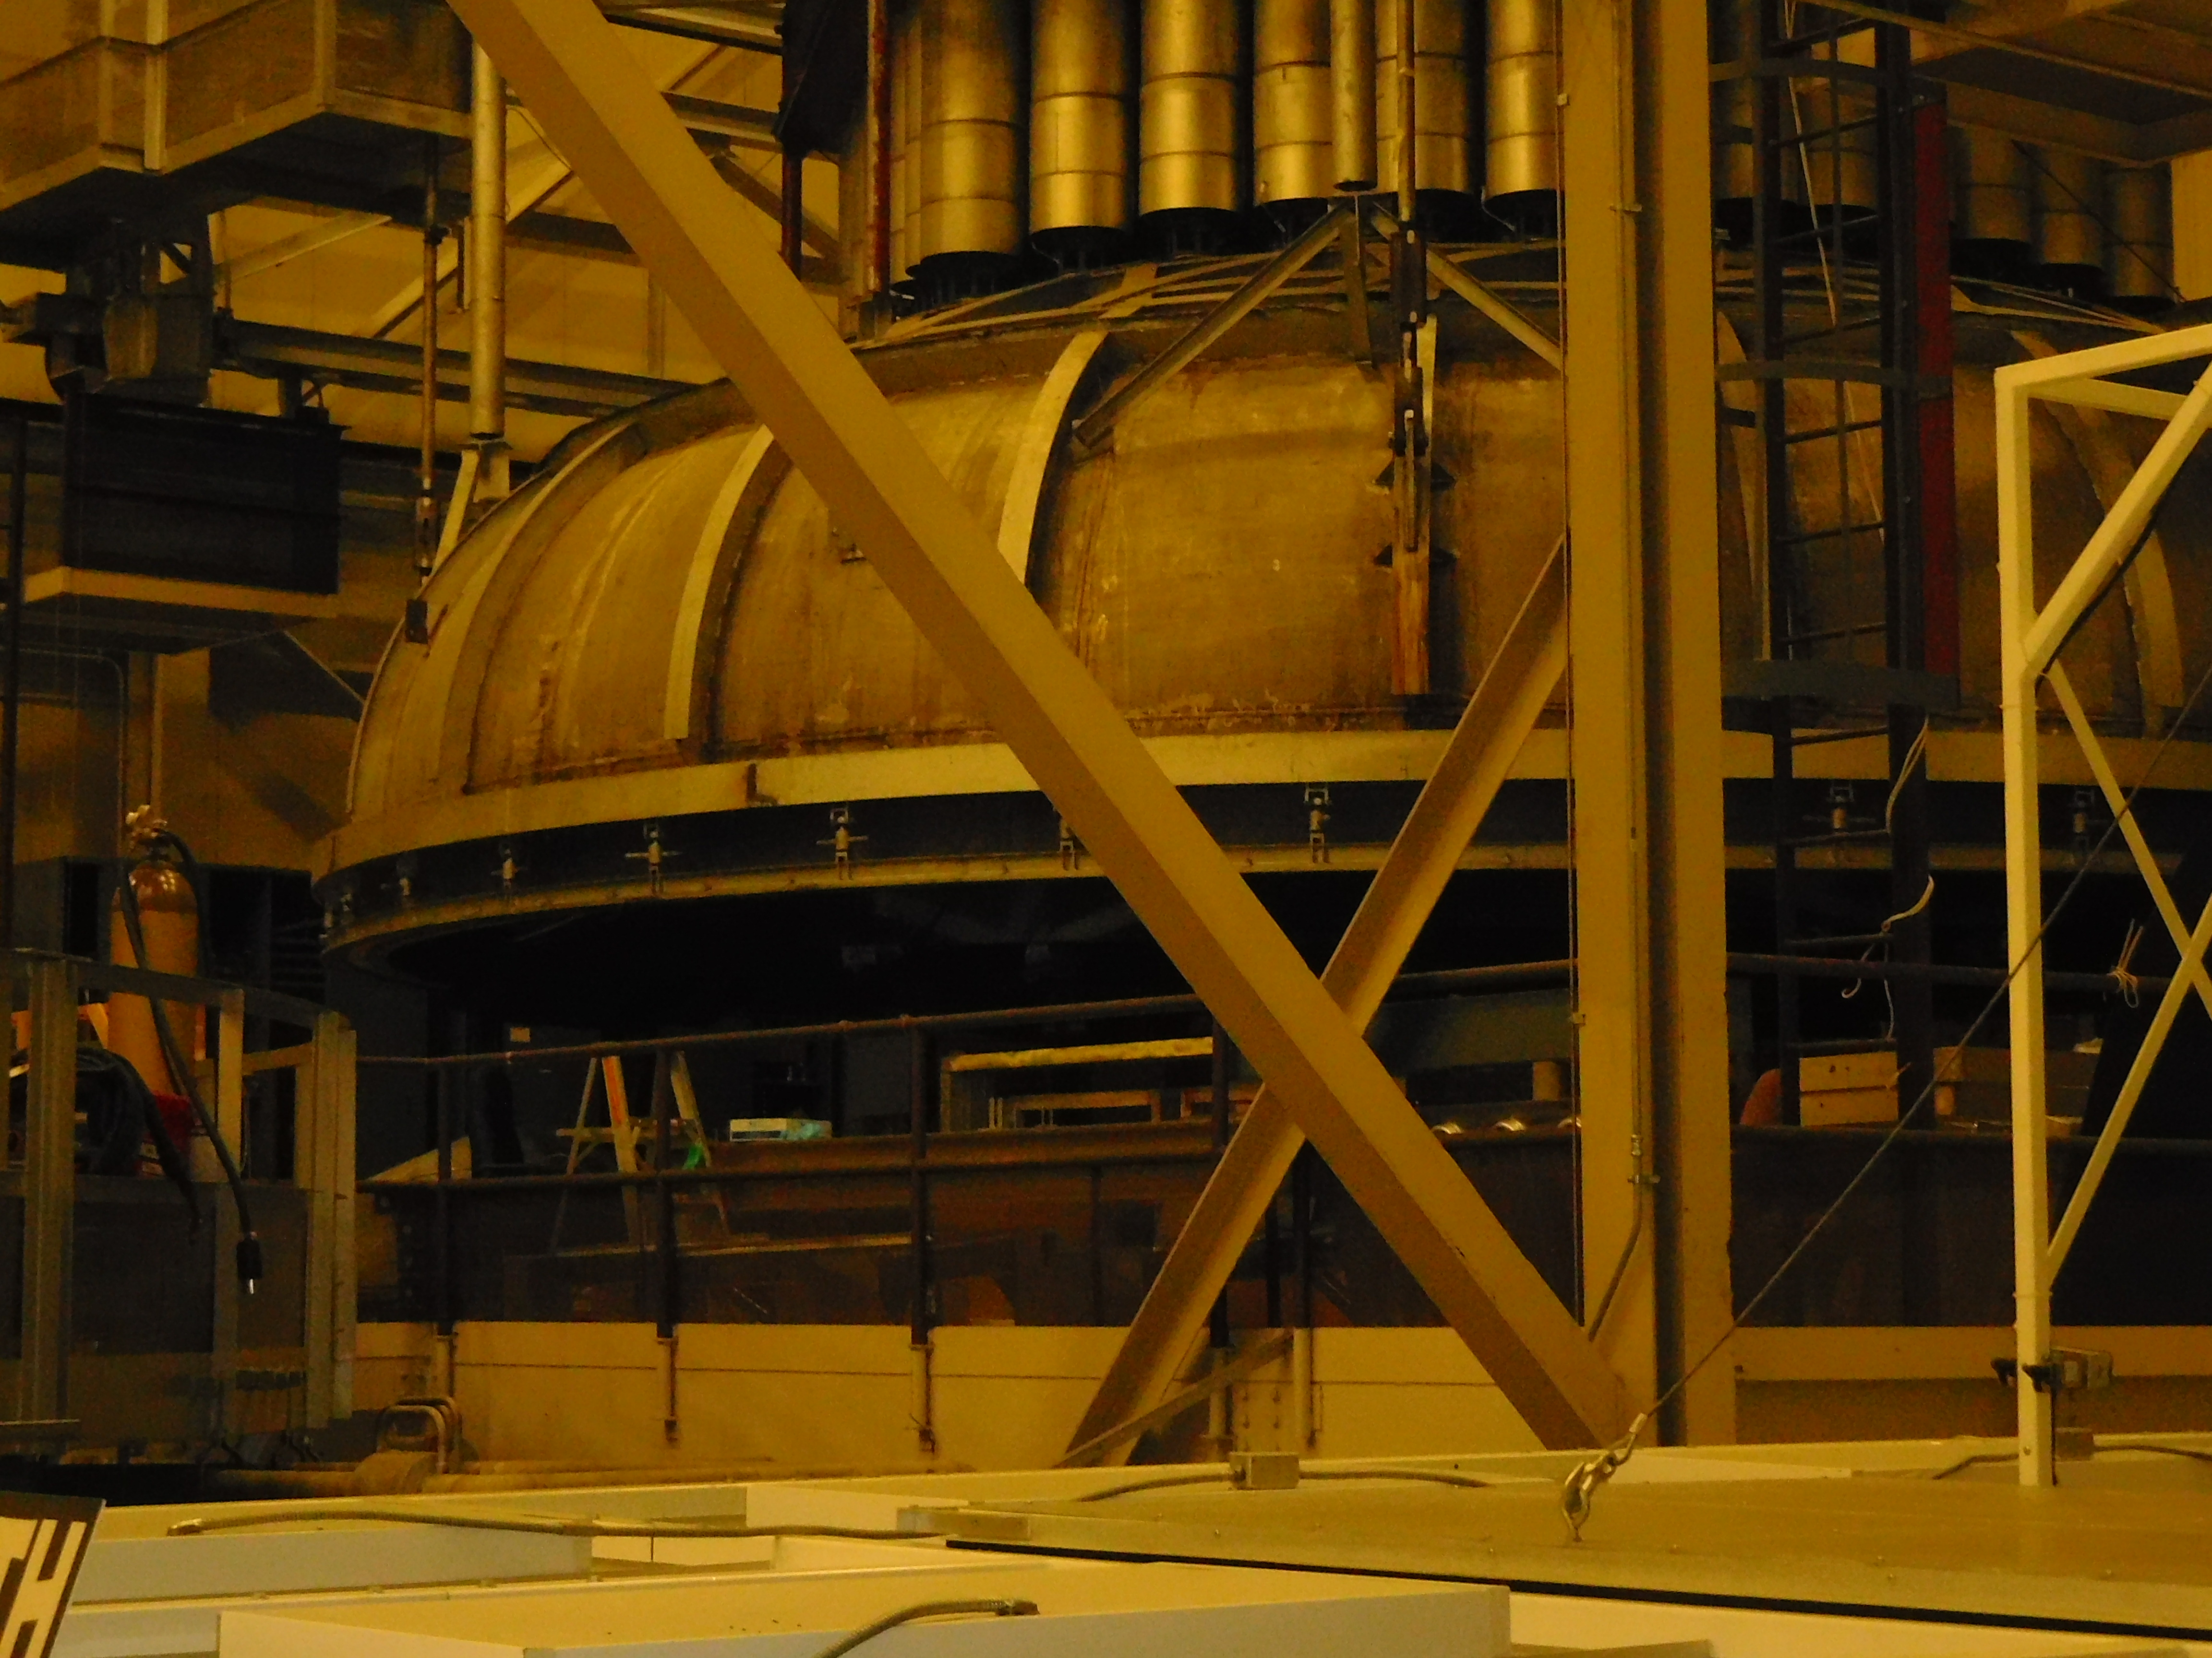
Notes:
The top of the SES where it is slid aside to insert the spacecraft

Slide 53
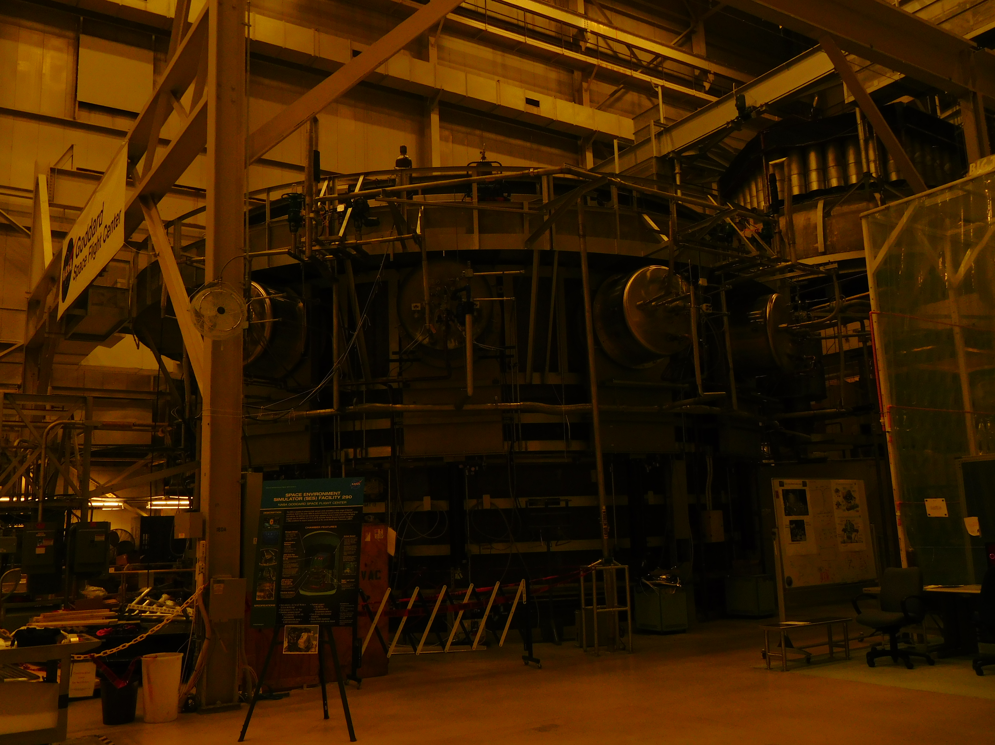
Notes:
Another view of the SES with the top slid over

Slide 54
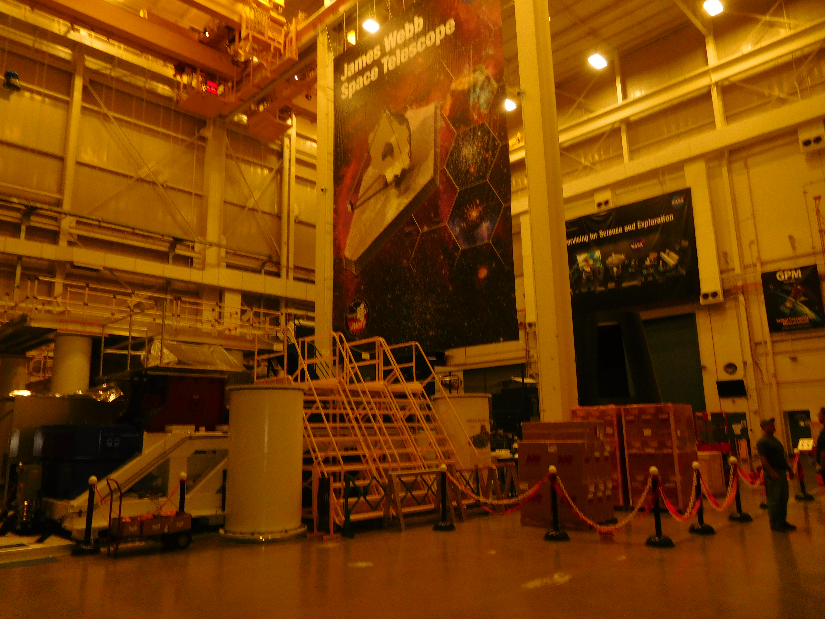
Notes:
The delivery room where all spacecraft are loaded onto a vehicle and sent to the launch location or to another site

Slide 55
Launch Site Testing
GSFC
CNE LAN
CNE Support
CNE Support
4 Mbps
NISN
DOORS Firewalls
CNE
FDF
MOC
Open IONet
CNE
Mission Critical
IONet Firewalls
R/T Mission Critical
GSSC
Restricted IONet
Building 14
4 Mbps
4 Mbps
Secure Gateway Firewall
R/T Mission Critical
MCE
Bld 2
NASA Center Network
Closed IONet
NASA Center Network
Abilene Network
To MVS
Leased NISN Circuit 4 hours to restore
Best Effort
256 kbps
To MVS
To MVS
1.544 Mbps
Open IONet
LISOC
GIOC
1.544 Mbps
512 kbps
56 kbps
Abilene Network
5 Mbps
1.544 Mbps
NISN 740 Mux/Demux
4 Mbps
SCAMA Voice Circuits
GD
GBM IOC
SCAMA Voice Circuits
NISN
Router
Open
IONet
Best Effort
Restricted IONet
Closed IONet
Closed IONet
S/C OPS2
SN COORD
MSFC
PIP WAN
SCAMA Voice Circuits
S/C OPS1
4 Mbps
Open IONet
4 wire Analog Voice
Best Effort
Restricted IONet
GFEP
LAT ISOC
MOC W/S
4 Mbps
Comm
Box
#1
SLAC
SN COORD, S/C OPS1
S/C OPS2, Delta Voice
I&T Firewall
Mission Critical
SN COORD, OPS1
S/C OPS2, Delta Voice
R/T Mission Critical
IGSE
R/T Mission Critical
Comm
Box
#2
Mission Critical
4 hours restorable
SN COORD, Delta Voice
Mission Critical
USN NMC
GD GSE
Hot Bench
Comm.
Box
#3
S/C
Simulator
Contingency
MOC
Hangar AE
GFEP
PBE
GFEP
RTE
WDISC
DAS
PTP
S/C I&T
April 14, 2005
Howard Dew
Code 581
Legacy
Systems
Comm.
Box
#4
Astrotech
Ku-band
front-ends
KSC
WSC
GSFC
Contractor I&T Facility
7

Slide 56
Spacecraft and Observatory Instrument Testing After Launch
The Commissioning Plan developed by the scientists prior to development is used to test and validate each instrument
This testing of the spacecraft subsystems takes place immediately after launch
The first system to be deployed is the solar array and is of extreme importance because the spacecraft is being powered by one or more batteries which only lasts a finite number of hours
All of the spacecraft subsystems are monitored by the MOC
The observatory instrument voltages both high and low are brought up prior to the instrument(s) checking and calibration testing
After the instruments are calibrated properly then the science operations begin
This may take anywhere from one month to six months depending on the number of instruments and the size/complexity of the mission

Slide 57
Ongoing Support of the Satellite and Science Data Processing
The MOC continues the support of the mission with the Flight Operations Team monitoring the spacecraft
The SOC monitors each instrument and continues to receive the science data
The SOC prepares the commands for each instrument which is sent to the CMS in concert with the MOC sending spacecraft commands to the CMS to develop a command load for the spacecraft
The MOC then sends the command loads to the satellite for on-board processing
Each scientist processes the data from their instrument and evaluates the results

Slide 58
Spacecraft Bus and Launch Vehicles
Spacecraft Bus
  This is built by a contractor company to the specifications to support the observatory
  The delivery is made to the organization (NASA, ESA, etc) and is then goes through all of the testing prior to the mating of the observatory
  After mating of the bus and observatory, testing goes into high gear – EMI, thermal vacuum, vibration and finally the SES
  Delivery is then made to the launch site where testing is again done to ensure that no problems occurred during transport
Launch Vehicle
  There are many launch vehicles from small (Pegasus or Antares) to a medium size (delta) to the largest vehicles ( Titan and the European Ariane 5 or 6 )
  They are supplied to the mission by the contractor company and are controlled by that company to launch
  The spacecraft bus/observatory is then mated to the launch vehicle and many more tests are conducted to ensure that every subsystem is working properly

Slide 59
AND FINALLY LAUNCH DAY HAS ARRIVED AFTER MANY YEARS OF SWEAT AND DETERMINATION
EVERYONE’S FINGERS ARE CROSSED
THE LAUNCH IS CONTROLLED FROM THE LAUNCH SITE WITH SUPPORT OF THE LAUNCH VEHICLE CONTRACTOR

Slide 60
Launch Day – Falcon Heavy Rocket
https://www.youtube.com/watch?v=lS9XcEEek48

Slide 61
Conclusion and Issues
Conclusions
The amount of testing and continual re-testing of all systems provides a good probability for mission success
The cost of each mission depends on both on the size of the project but more importantly on the engineering requirements needed to support the science goals and to build the instrument suite
Issues
The main issue is with the number of satellites already in orbit but the doubling of the new missions to an already overcrowded LEO and MEO
There are over 1400 satellites in orbit presently
The amount of orbital debris in orbit around the earth is expanding every year
Estimation of 75 to 125 million pieces of debris from no bigger than a small chip to a non functional satellite still in orbit

Slide 62
Citations
Space Mission Analysis and Design, 3rd edition, James Wertz and Wiley Larson
NASA Headquarters Information and Project Life Cycle Module
Goddard Space Flight Center WIND spacecraft
“The System Approach to Successful Space Mission Development”, Eric Hoffman and Glen Fountain, APL
Design of Mission Operations Systems for Scientific Remote Sensing, Stephen Wall and Kenneth Ledbetter
Wikipeadia – Orbits of satellites
Launch Site Testing and Processing, Howard Dew
CCSDS Packet Telemetry
CCSDS Packet Command
SPIE – Society for Optical Engineering
Discover magazine July/August 2017

